Slide 1
Forest surveillance with artificial intelligence and digital technologies
Introducing the FORSAID project
Speaker
Affiliation
Contact details
Event, DD / MM / YYYY

Slide 2

















General information
17
10
partner institutions
countries
4.9
42
million € in funding
months duration
(Sep 2024 – Feb 2028)

Slide 3










Main goal and objectives
Developing a comprehensive combination of innovative digital technologies for the early detection of pests and pathogens of European forest trees
WP2
Remote sensing
WP5
Deployment strategy with stakeholders
Chosen methodology
WP4
Citizen science
WP3
Ground sensors
A multidisciplinary approach across spatial and temporal scales

Slide 4

Improving
Current knowledge in digital techniques applied to pest detection / monitoring
Automation processes for pest identification using machine learning and AI
Scientific
level

Slide 5

Testing and improving
Remote sensing symptoms detection
Automatic ID
Proximal tree health scanning tools
Methodologies for citizen science campaigns
Applied
level

Slide 6

Developing
A platform for continuous forest monitoring using remote sensing and deep learning
Automated monitoring system at the local scale using drones or trap networks
Automatic systems for imaging pest ID
Innovation
level

Slide 7

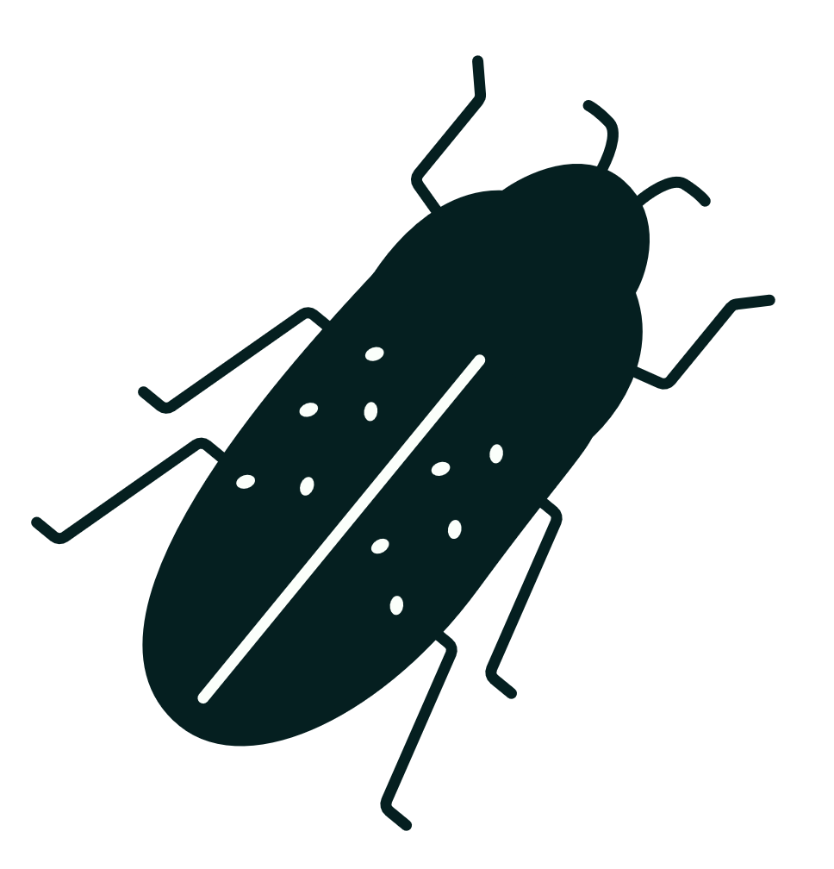

Target regulated pests
Fungi
Insects
Nematode
Ceratocystis platani
Cryphonectria parasitica
Fusarium circinatum
Agrilus anxius
Agrilus planipennis
Ips typographus
Thaumetopoea pityocampa
Thaumetopoea processionea
Bursaphelenchus xylophilus

Slide 8
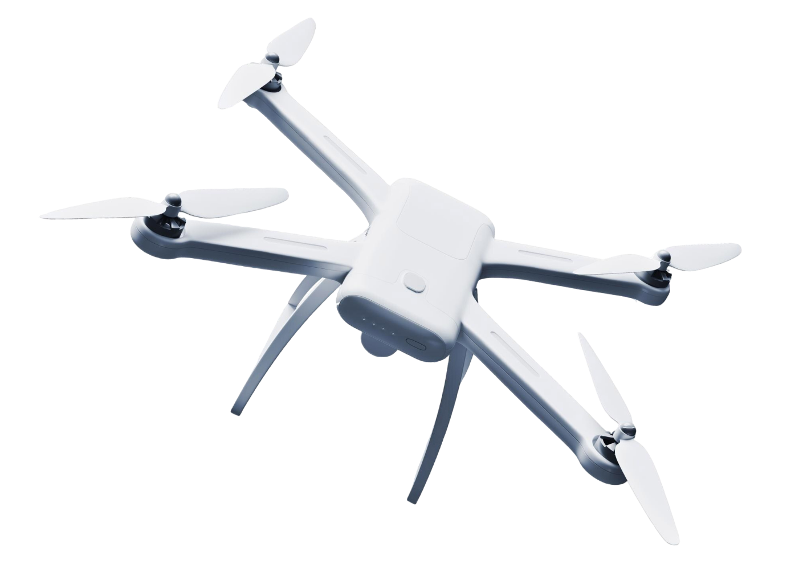
Work Packages

Slide 9

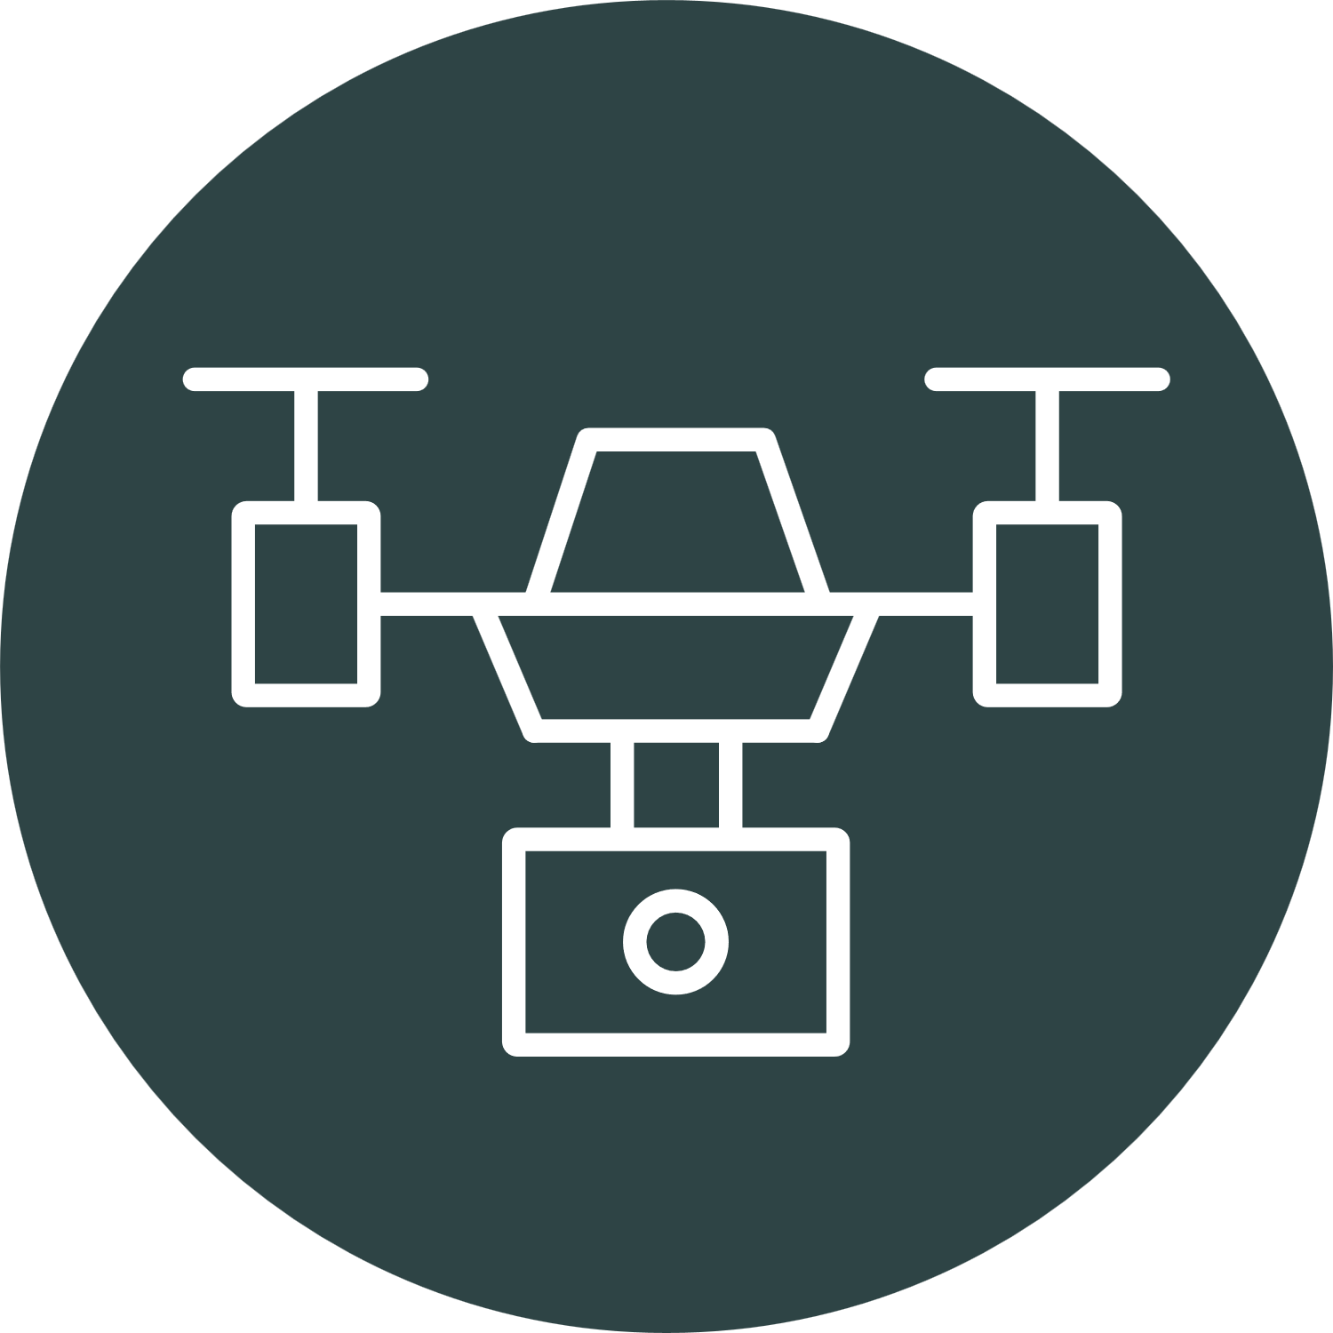

WP2: Remote sensing
Technology
Satellites
Plane-Drones
Phenotyping robots
Scale
Large
Medium
Small
Production type
Natural
Urban settings
Nursery
Environment
Landscape / Stand
Stand / Tree
Laboratory / Greenhouse
Corythucha arcuata
Ips typographus
Thaumetopoea spp.
Agrilus planipennis
Ceratocystis platani
Cryphonectria parasitica
Fusarium circinatum
Case study
Bursaphelenchus xylophilus
Ceratocystis platani
Stakeholder type
Forest health managers
Urban tree managers
Nursery managers

Slide 10
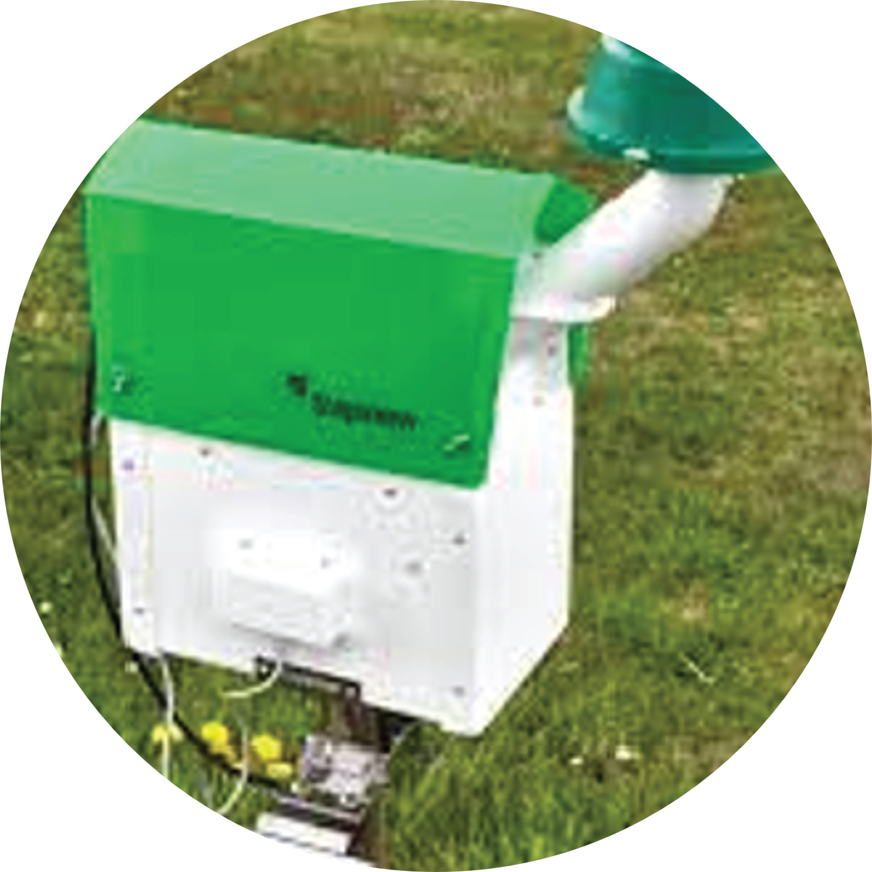
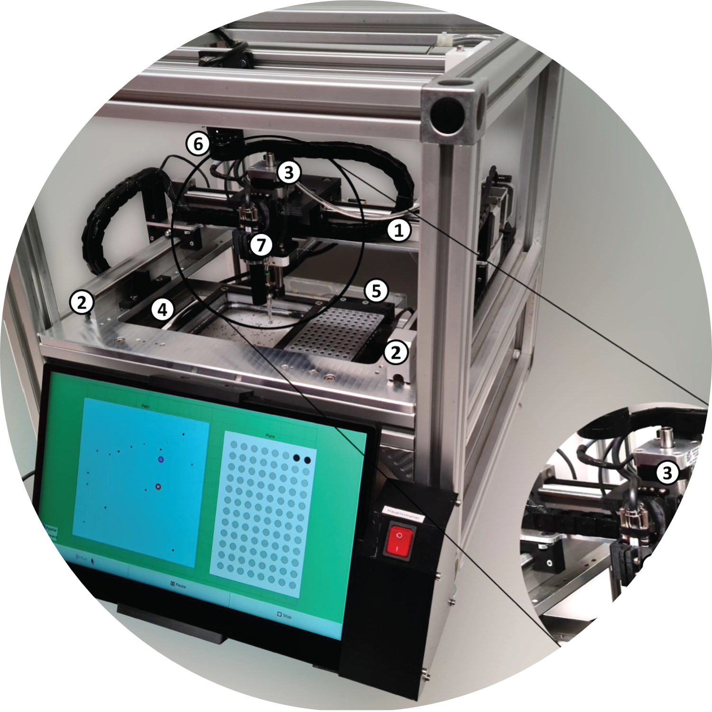
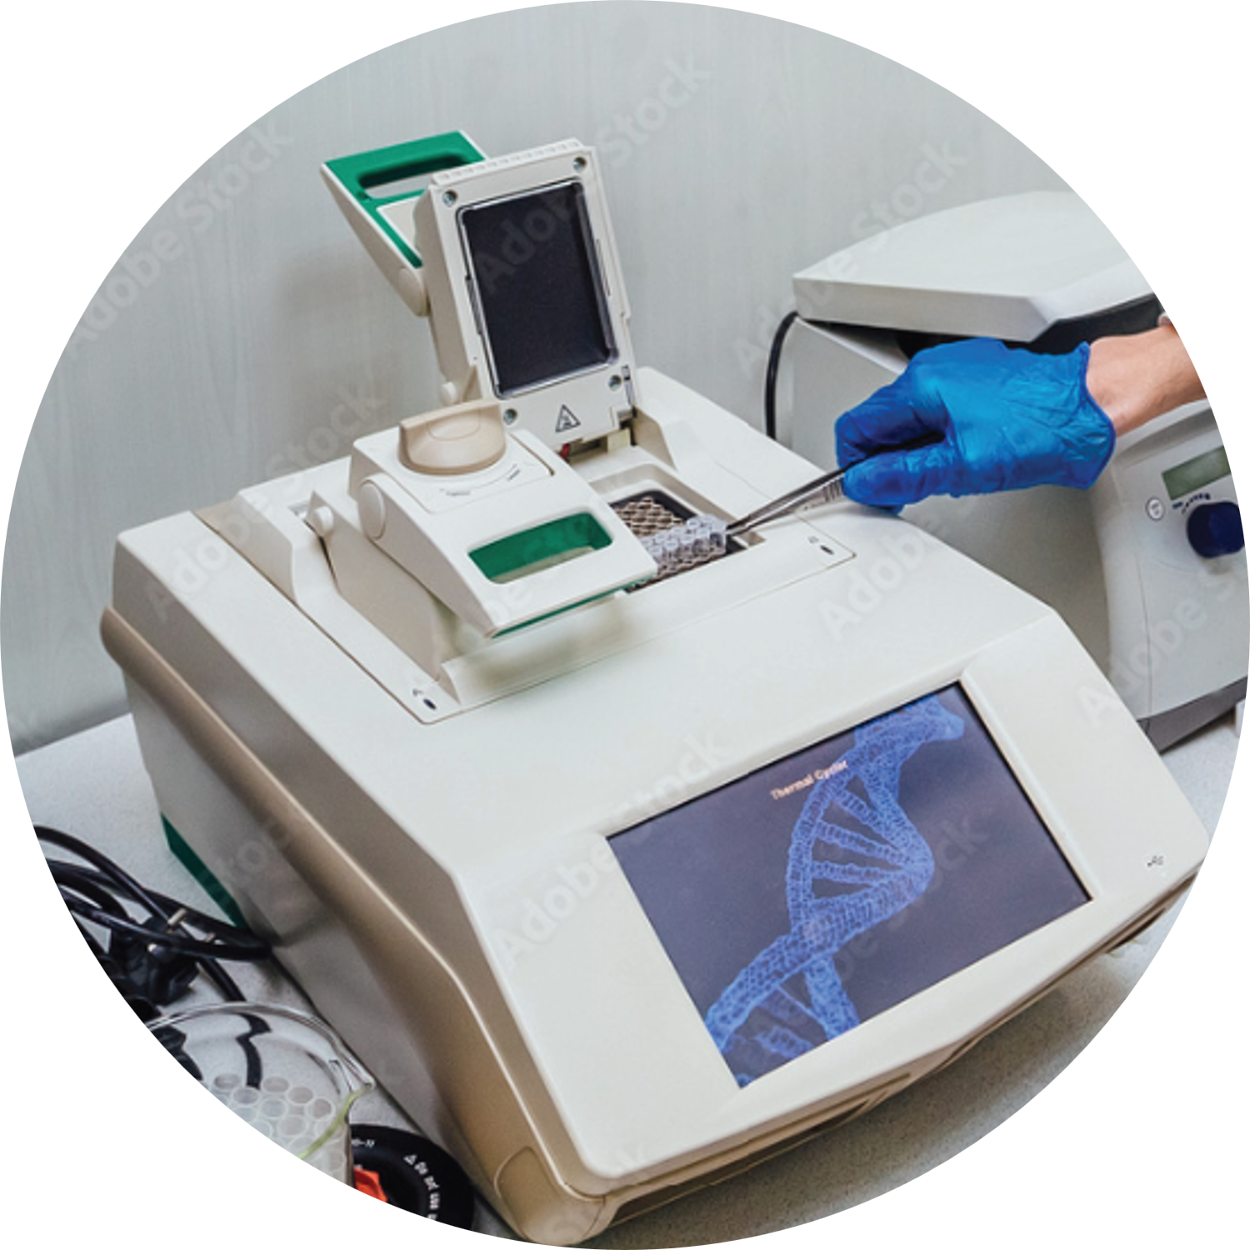
WP3: Digital technologies for ground detection and surveillance
Technology
Smart traps
Entomoscope
DNA barcoding
Environment
Field
Field / Laboratory
Laboratory
Agrilus spp.
Ips typographus
Monochamus spp.
Agrilus spp.
Bursaphelenchus xylophilus
Ceratocystis platani
Cryphonectria parasitica
Case study
Ips typographus
Thaumetopoea spp.
Forest and tree
health managers
Urban and tree health managers
Nursery and tree health managers
Stakeholder type

Slide 11
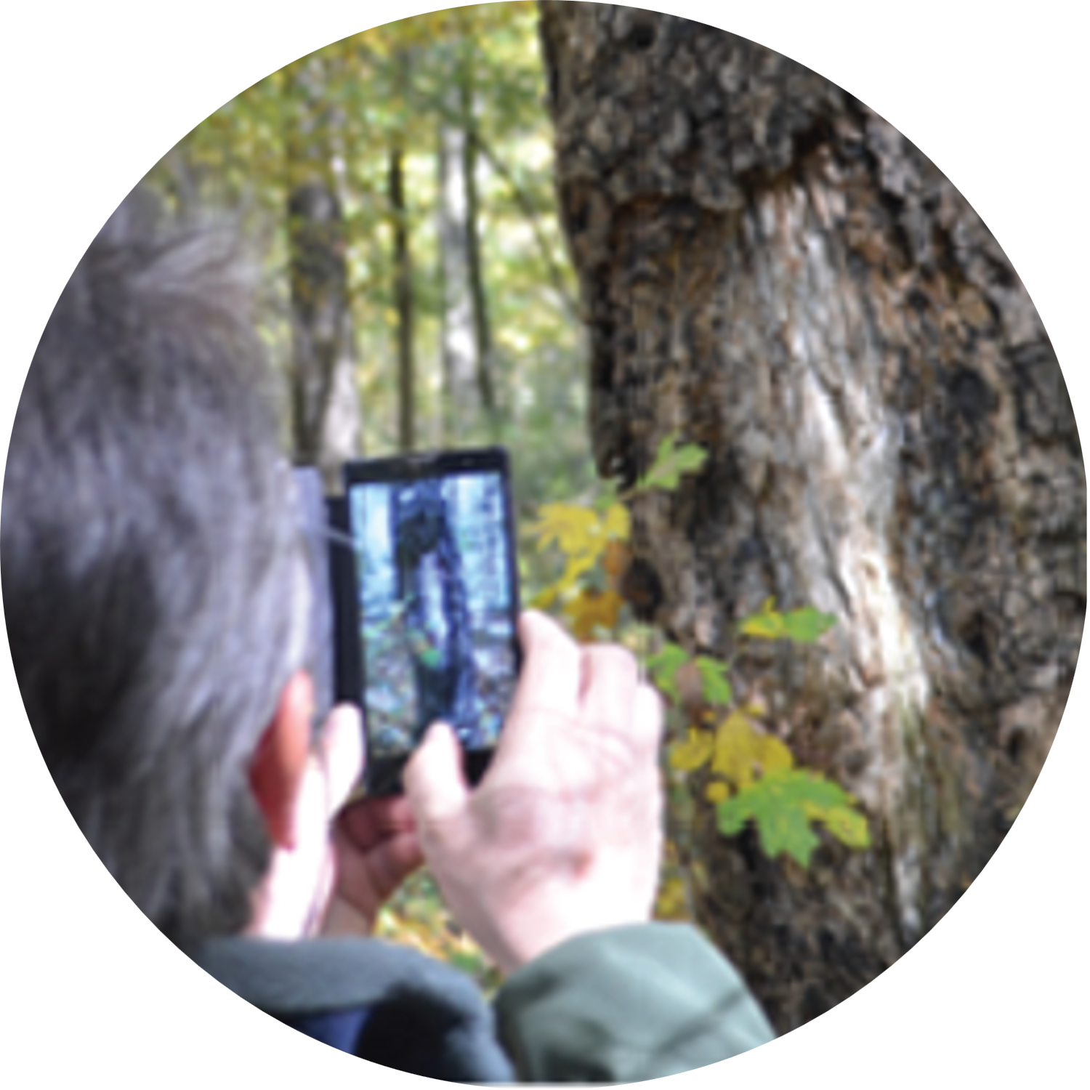
WP4: Citizen science
Mobile
apps
Automated species
recognition
Technology
Environment
Field
Web
Case study
All
Agrilus spp.
Thaumetopoea spp.
General public, forest owners
General public, forest owners
Stakeholder type

Slide 12



WP5: Deployment strategy with stakeholders
Stakeholders' opinion on digital technologies for forest pest detection
Cost-benefit analysis of new digital technologies
Decision making tool for implementing relevant digital technologies
Tasks
Environment
Europe
Europe
Europe
Case study
All
All
All
Stakeholder type
Forest owners, forest managers, nursery managers, NPP officers, custom officers

Slide 13



WP6: Communication, dissemination and exploitation
Project identity and branding
Communication strategy
Stakeholder and policy engagement
Tasks
Public sphere
and online
Public sphere
and online
Public sphere
and online
Environment
Forest owners, forest managers, forest researchers, policy actors
Stakeholder type
All
All

Slide 14




Expected impacts
Increase the availability of large-scale methods to monitor plant pests for timely eradication or optimisation of containment measures
Enhance integration of methods such as remote sensing, networks of traps, citizen science for surveillance of EU regulated plant pests
Foster transdisciplinary cooperation in the fields of plant health, environmental sciences and earth observation
Support relevant EU and Associated Countries’ plant health policies

Slide 15




Follow
FORSAID’s journey!
FORSAID Project
forsaid.eu
FORSAID
forsaid.eu
Speaker
Affiliation
Contact details

