Slide 1
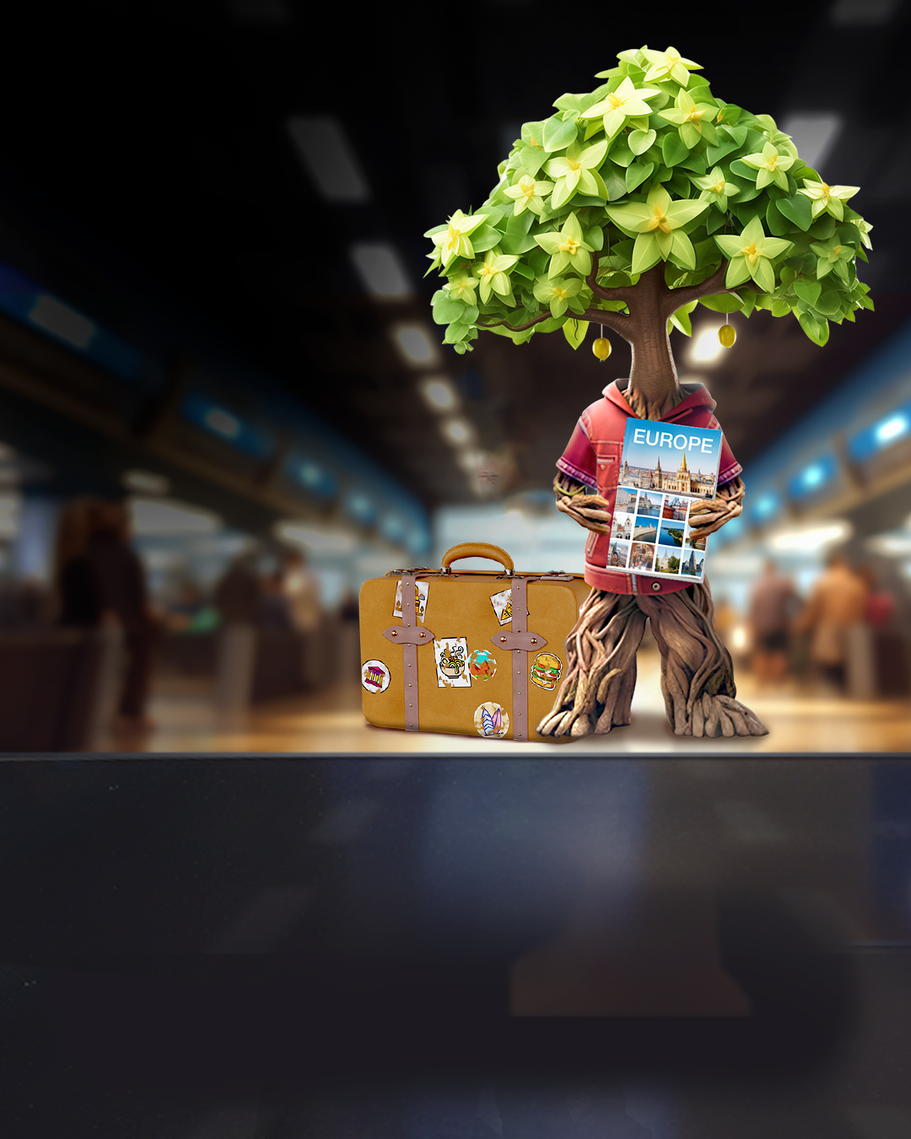
KEEP NATURE HEALTHY, don’t bring plants home
Bring nature home in your memories or on your camera, not in your luggage!​
#PlantHealth4Life

