Slide 1
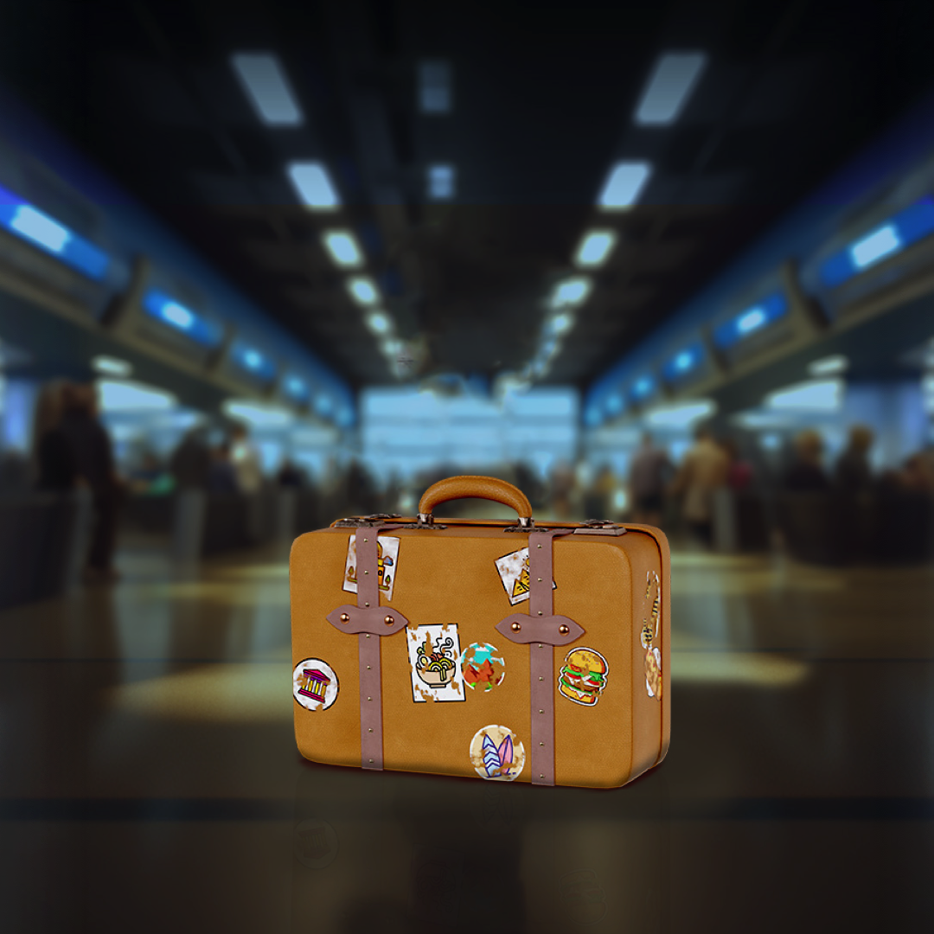
^{Travelling}
^{outside the EU?}

Slide 2

Take as many pictures as you want
^{of your favourite plants…}

Slide 3
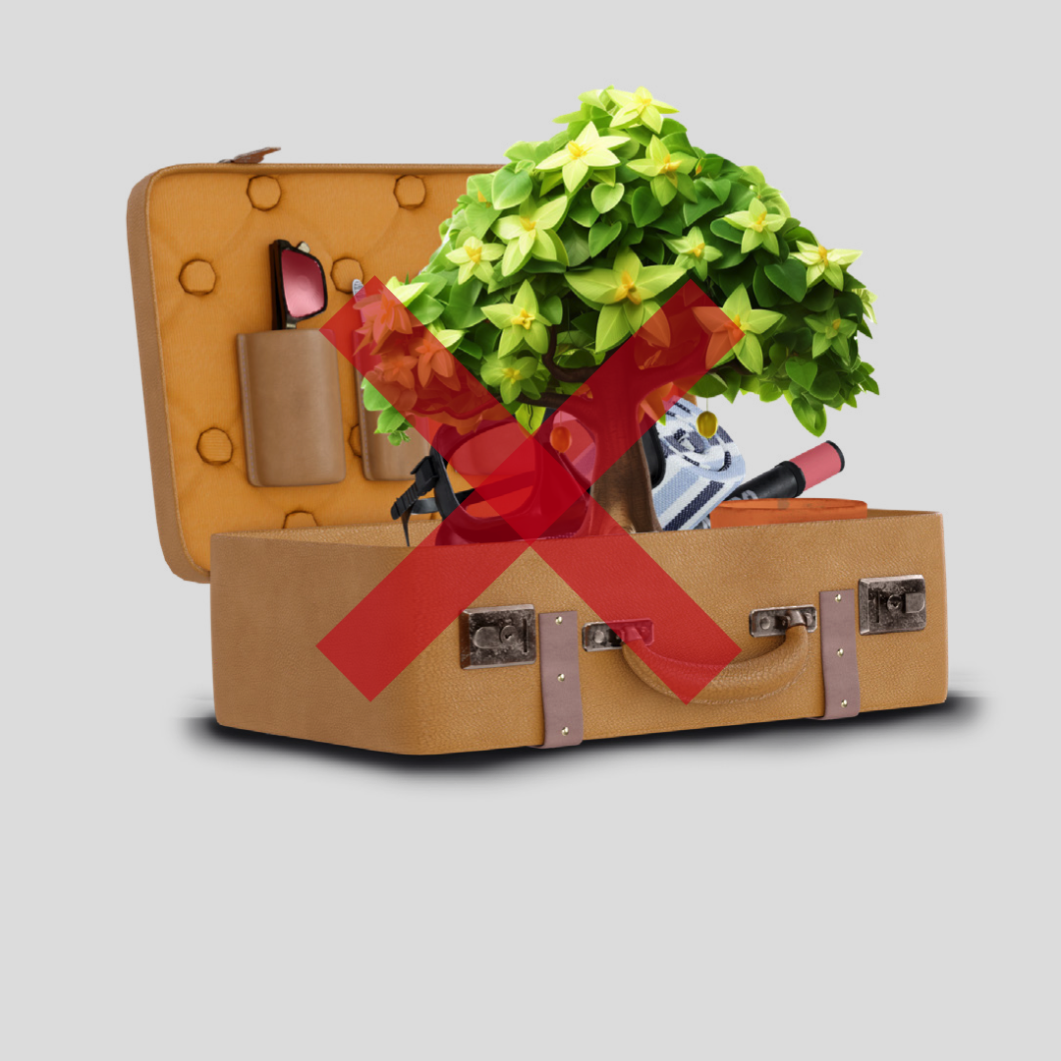
^{… but don’t bring them}
^{back with you.}

Slide 4
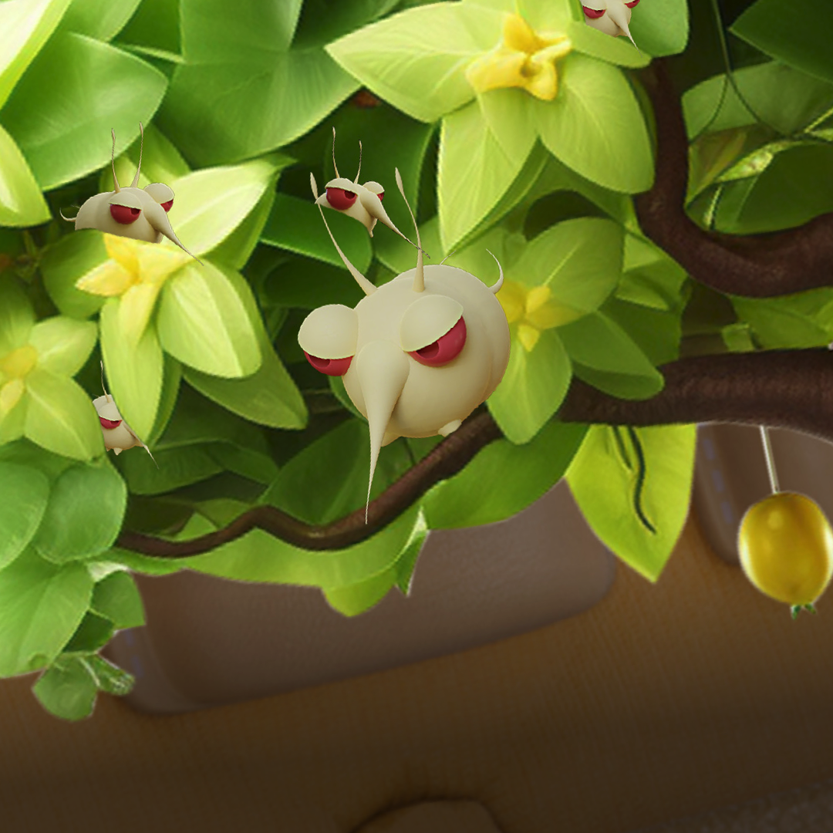
^{You could spread}
^{new pests by carrying}
^{them in your luggage.}

Slide 5
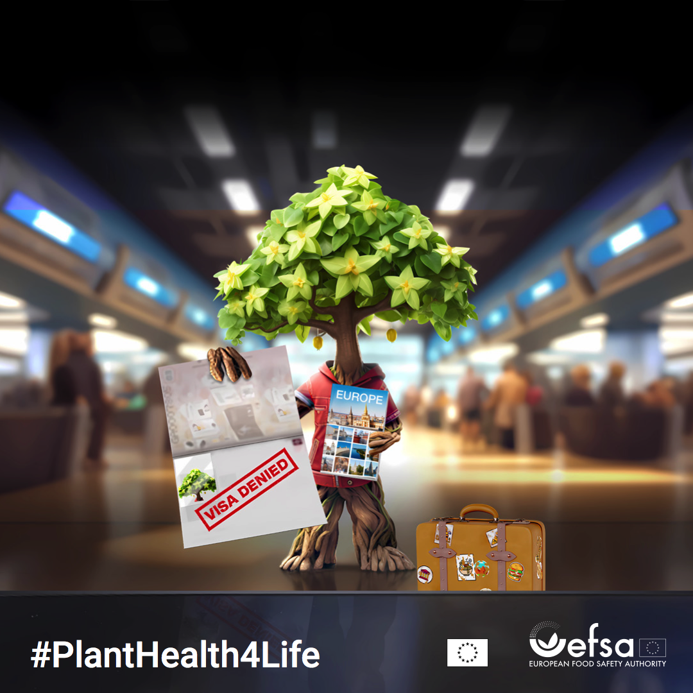
^{KEEP NATURE HEALTHY,}
^{don’t bring plants home}

