Slide 1
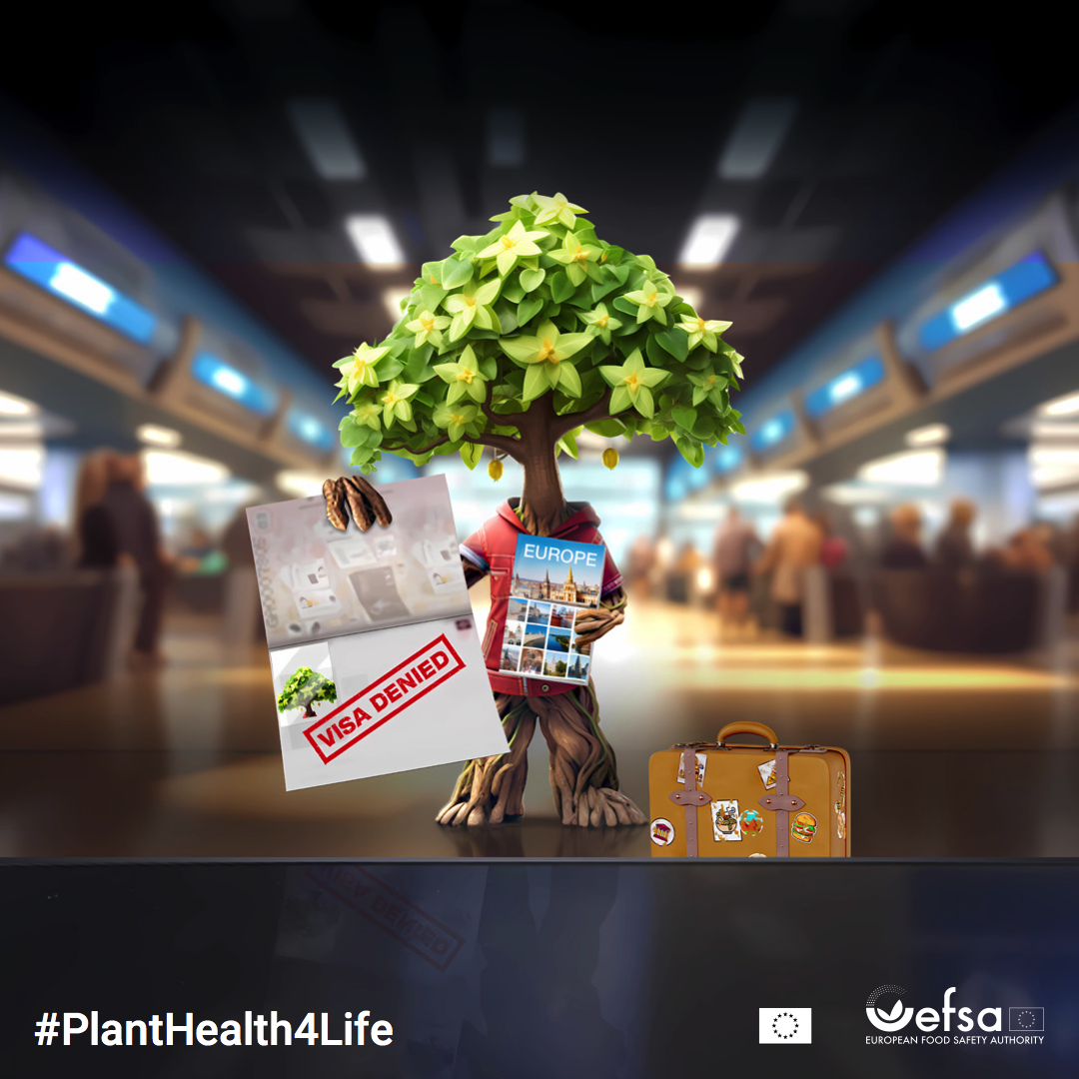
^{KEEP NATURE HEALTHY,}
^{don’t bring plants home}
Travelling outside the EU? Take pictures of your favourite plants, but don’t bring them back with you. Prevent the spread of new pests!

