Slide 1
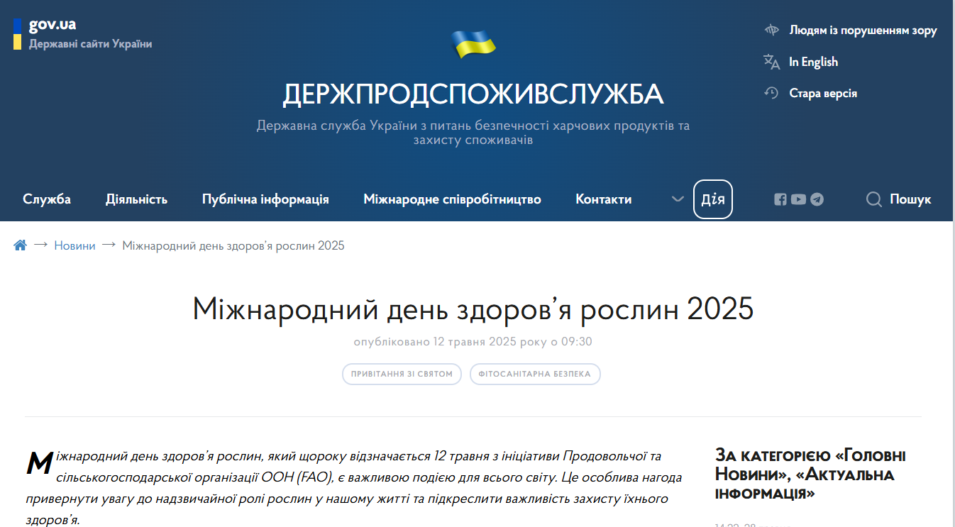
International Plant Health Day - 2025 in Ukraine
SSUFSCP
Greetings on the official web portal of the State Service of Ukraine on Food Safety and Consumer Protection from the Head of the State Service of Ukraine on Food Safety and Consumer Protection and the Deputy Head of the State Service of Ukraine on Food Safety and Consumer Protection, Chief State Phytosanitary Inspector of Ukraine

Slide 2
SSUFSCP
On the occasion of the International Plant Health Day, an article and a presentation were published on the official web portal of the State Service of Ukraine on Food Safety and Consumer Protection
Presentation: The importance of plants for human life and health
Article: International Plant Health Day: “The importance of plant health in One Health”

Slide 3
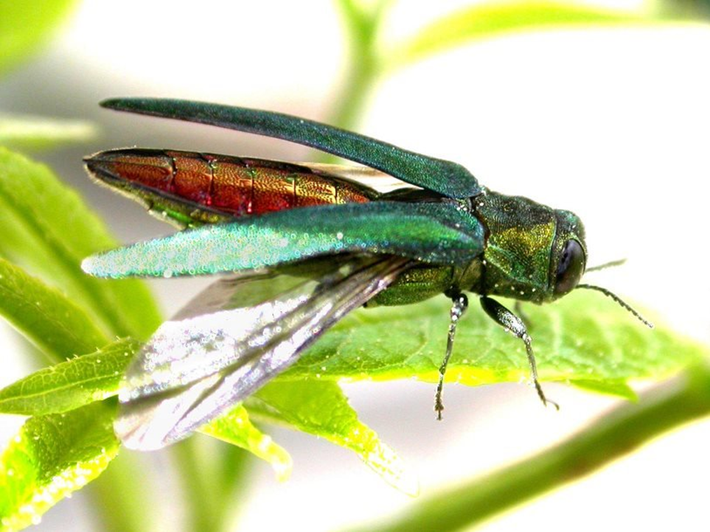
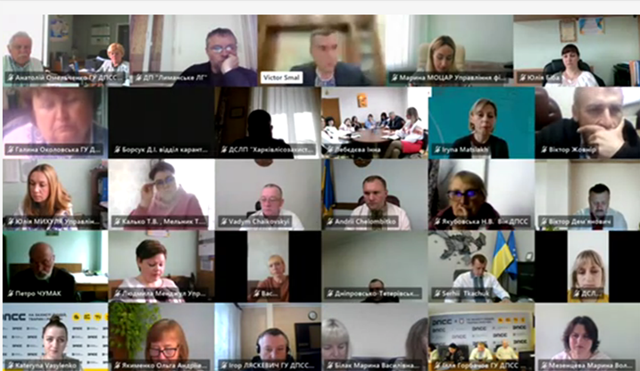
SSUFSCP
From May 12 to May 16, the State Service of Ukraine on Food Safety and Consumer Protection held the Week of Dissemination of Information on Emerald Ash Borer - Agrilus planipennis Fairmaire
The scientific and practical conference “Problems of Agrilus planipennis Fairmaire spread in Ukraine. Measures to detect, contain and eliminate outbreaks - experience and prospects, new challenges to prevent the spread of the pest”

Slide 4
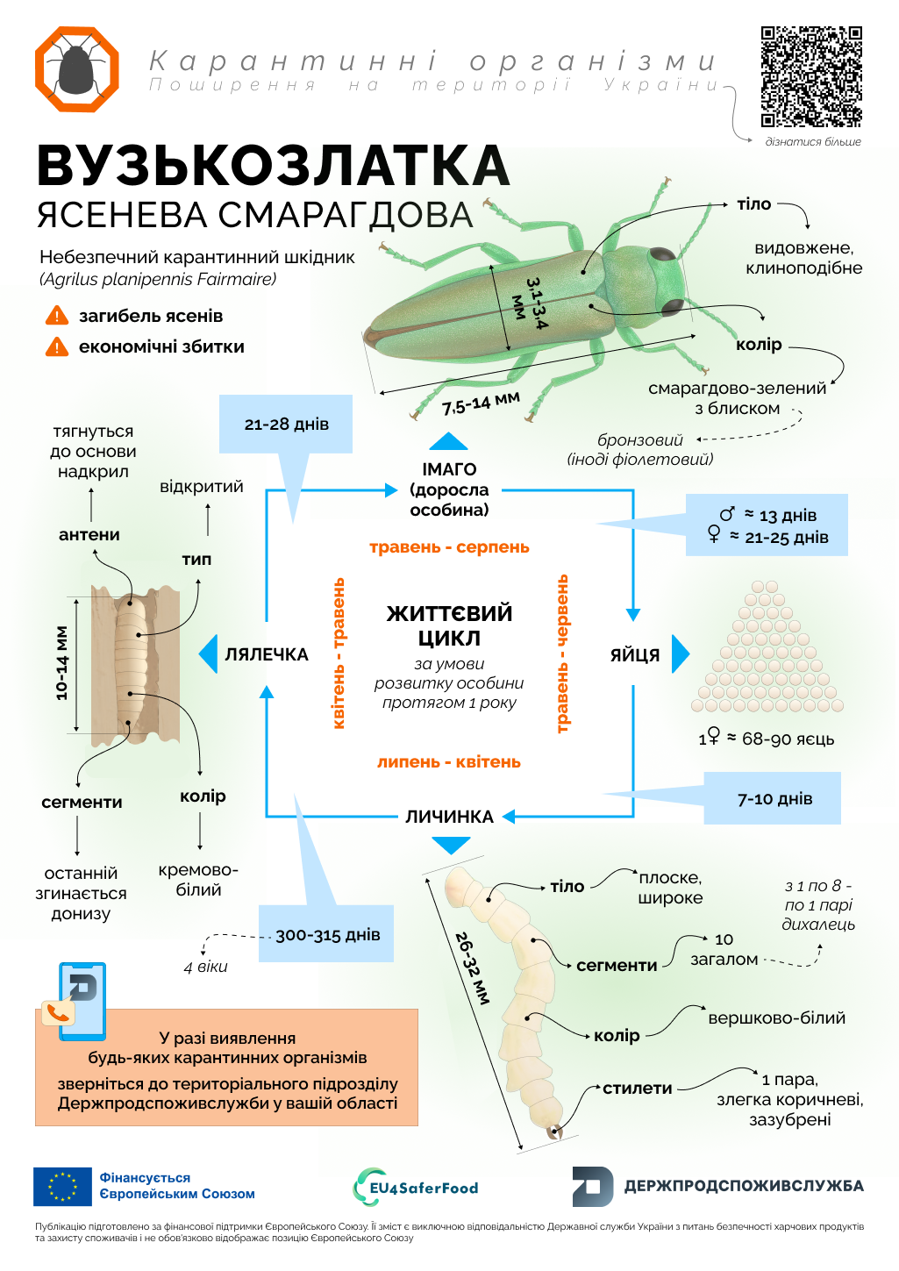
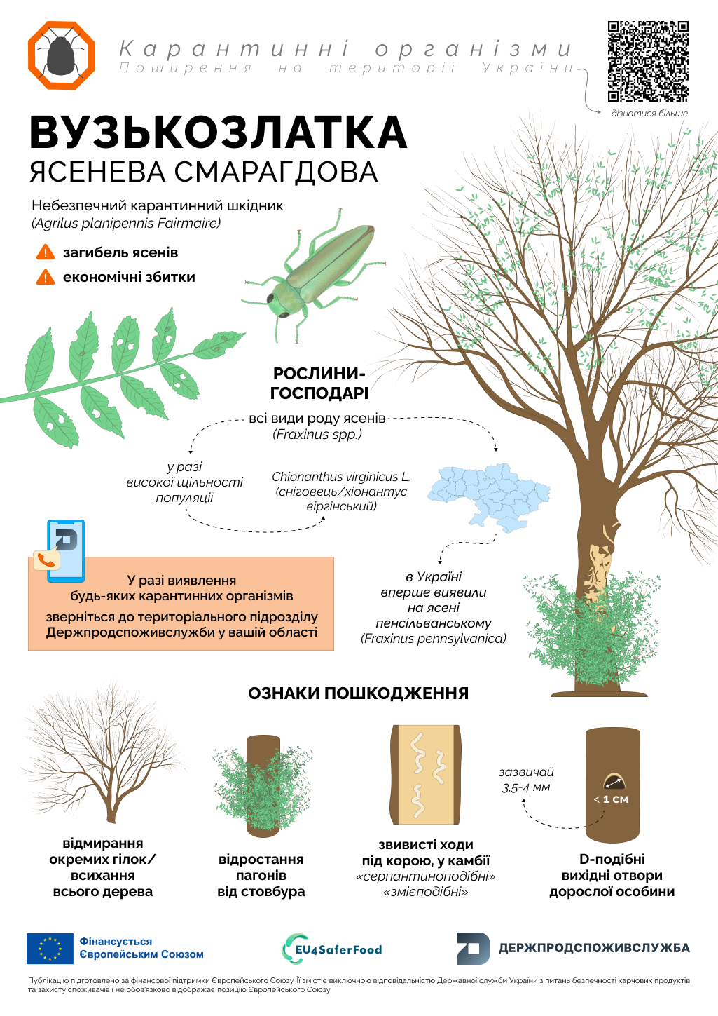
SSUFSCP
Leaflets with infographics dedicated to the Week of information dissemination about the Emerald Ash Borer - Agrilus planipennis Fairmaire
Morphological characteristics
Signs of damage

Slide 5
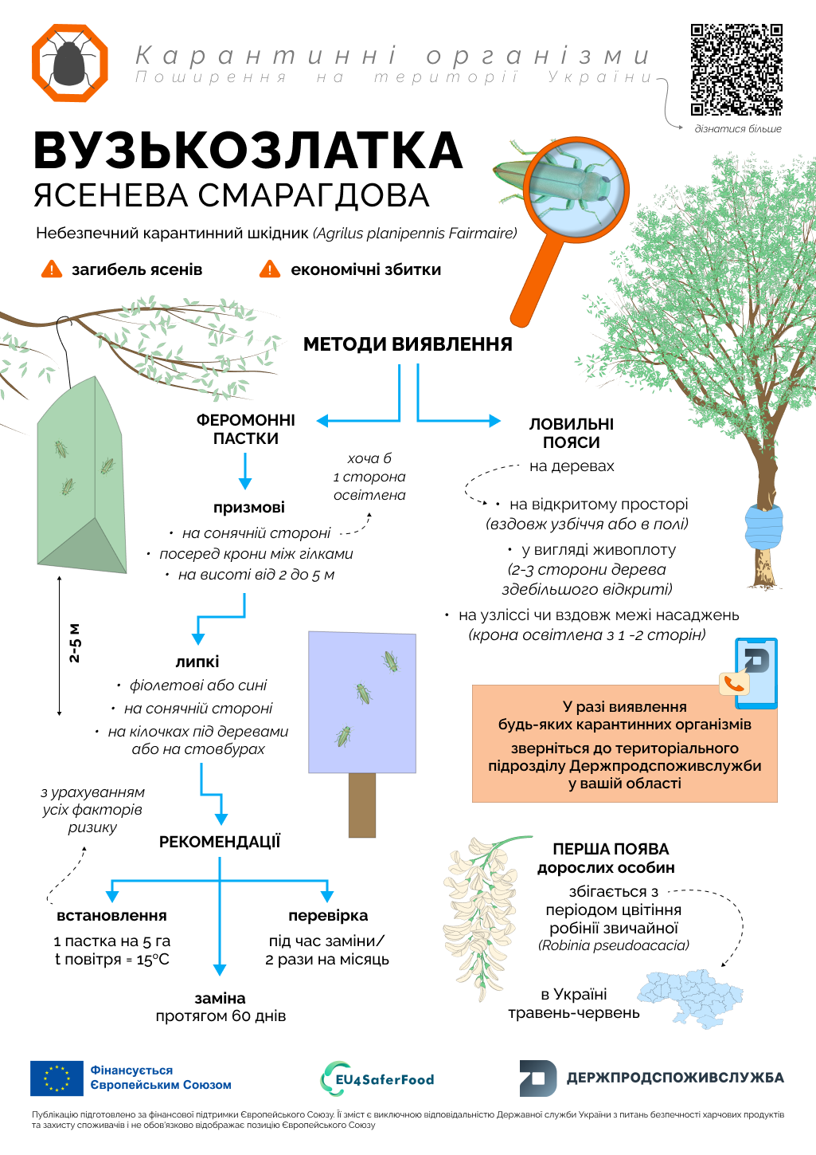
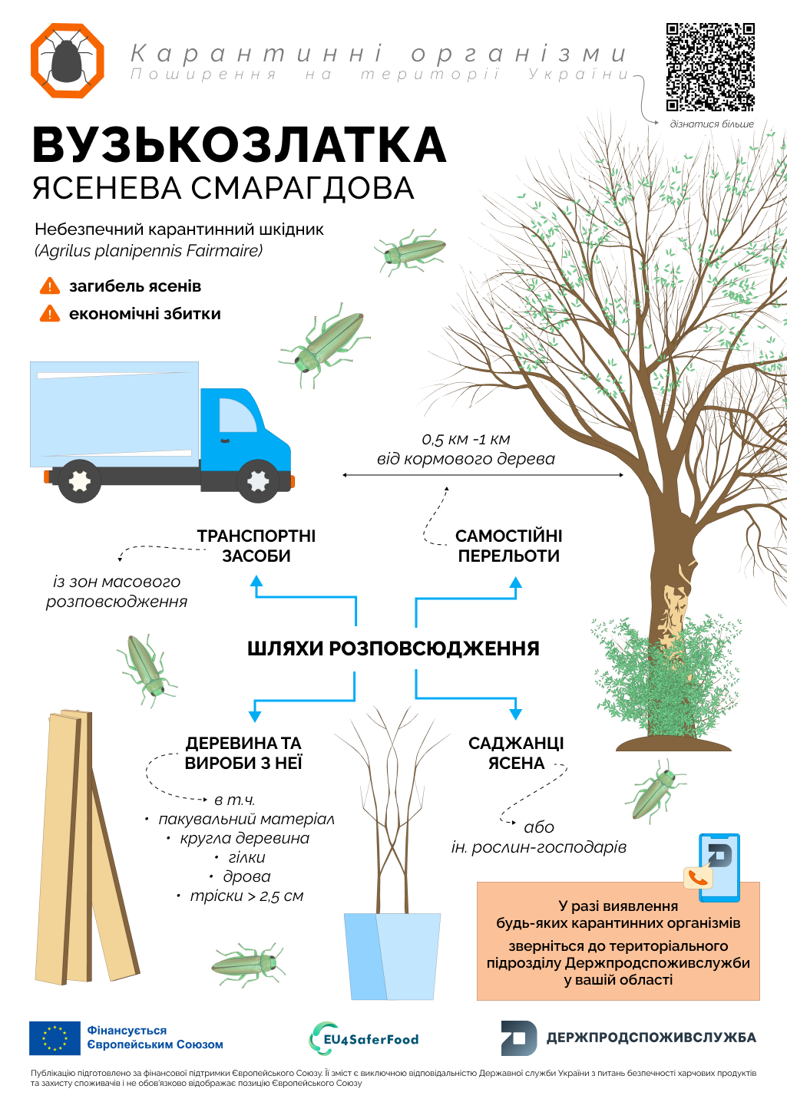
SSUFSCP
Leaflets with infographics dedicated to the Week of information dissemination about the Emerald Ash Borer - Agrilus planipennis Fairmaire
Detection methods
Ways of spread

