Slide 1
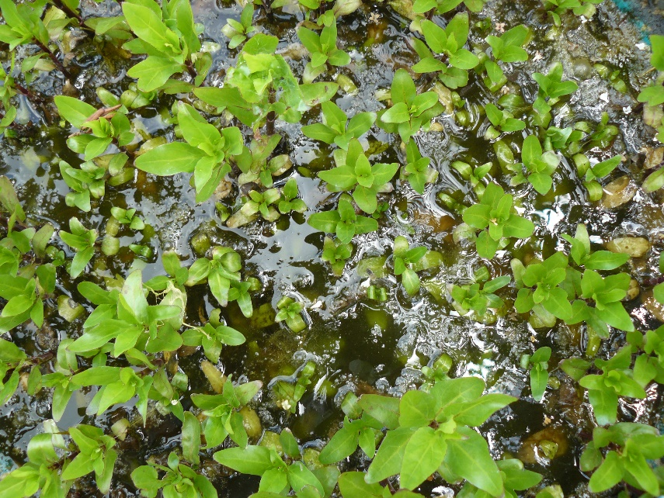
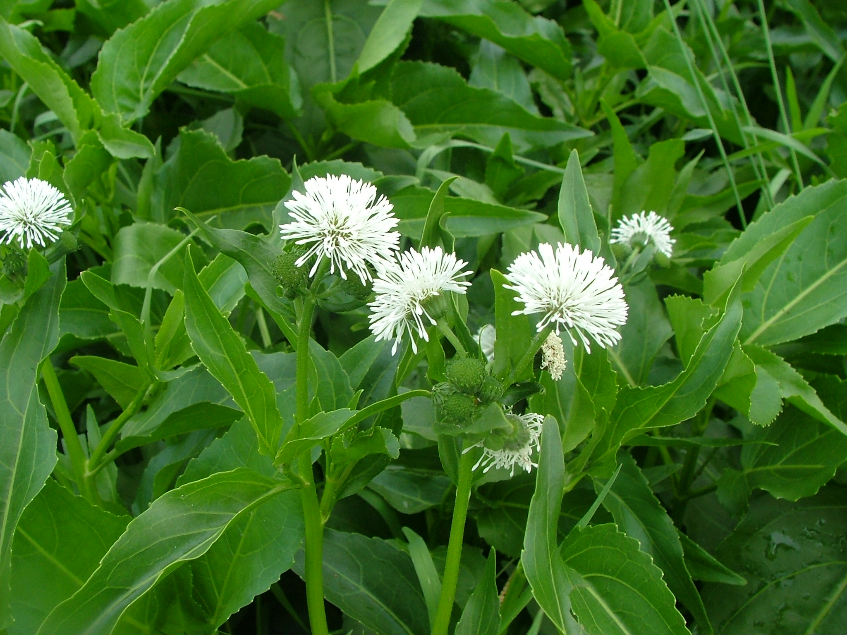
BE AWARE!
Gymnocoronis spilanthoides
A threat to waterways in the EPPO region
How to recognize it? Can you help us?
Gymnocoronis spilanthoides is an emergent perennial herb, either forming upright bushes up to 1.5 m tall, tangled sprawling floating mats or occasionally fully submerged in shallow water. Leaves lanceolate or ovate, opposite, 50 to 200 mm long 25 to 75 mm wide, serrate with wavy margins, veins pinnate. Submerged foliage usually entire but wavy margins, petiolate, 10 to 70 mm long. As a white flowered aquatic species, G. spilanthoides could potentially be misidentified for Alternanthera philoxeroides, though for this species the flowers are more compact, the petals are shorter in length and the leaves are shorter.
Because G. spilanthoides has the potential to seriously impact the habitats it invades, including native plant species, associated insects and important ecosystem services, it is important to report any sightings to plant protection authorities. Early detection will allow a rapid implementation of appropriate measures against G. spilanthoides .
If you see G. spilanthoides:
Check the identification of the species with other aquatic native plants.
Whenever possible, take a picture of the plant, record exact location, date and habitat where it was observed.
Contact us.
Contact us
Images: Paul Champion, EPPO Global Database
Your contact details
Your institution name
Logo
Images: Paul Champion, EPPO Global Database
This leaflet has been prepared within the LIFE funded project LIFE15 PRE FR 001 in collaboration with the NERC Centre for Ecology and Hydrology
Prepared in collaboration with EPPO – www.eppo.int

Slide 2
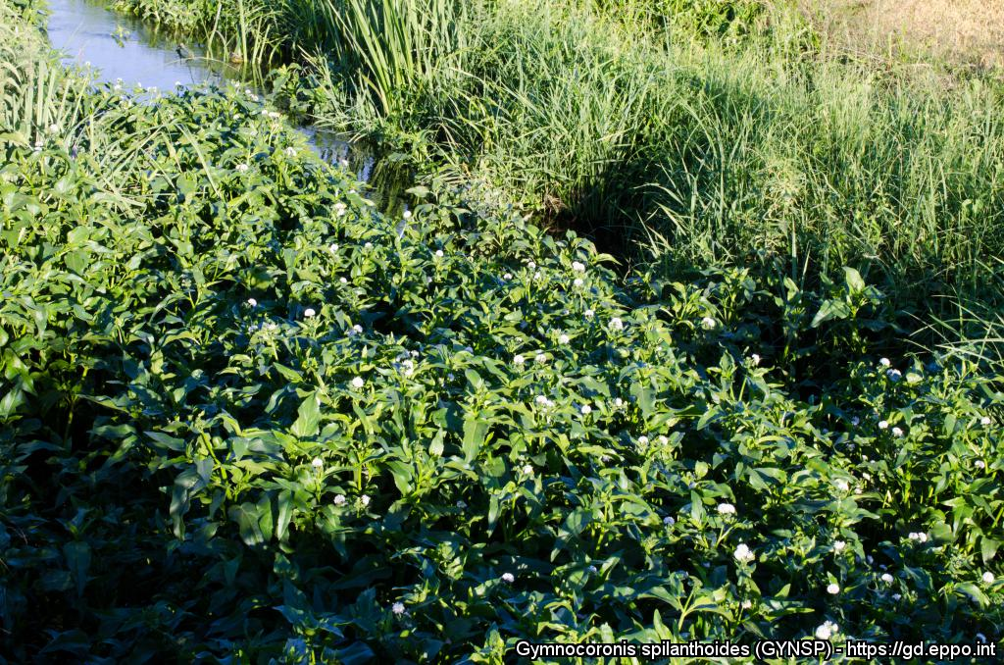
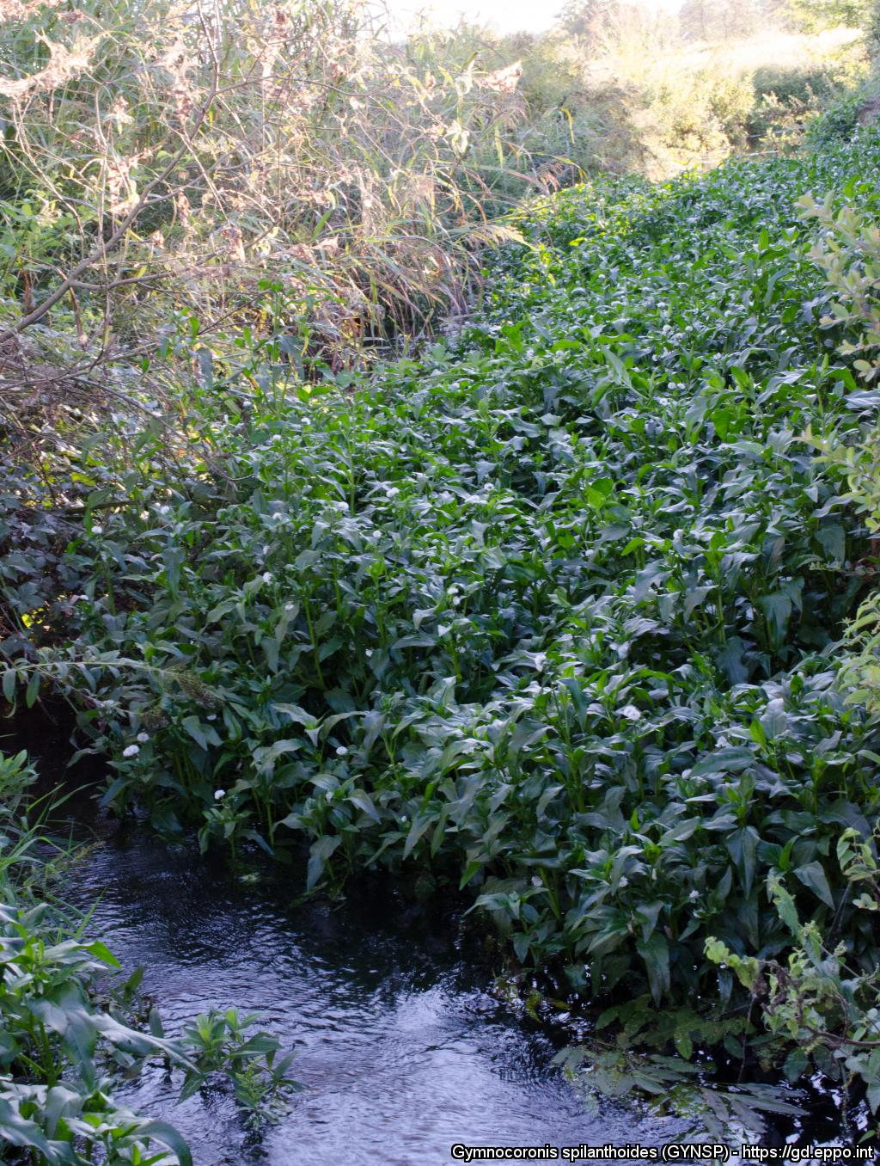
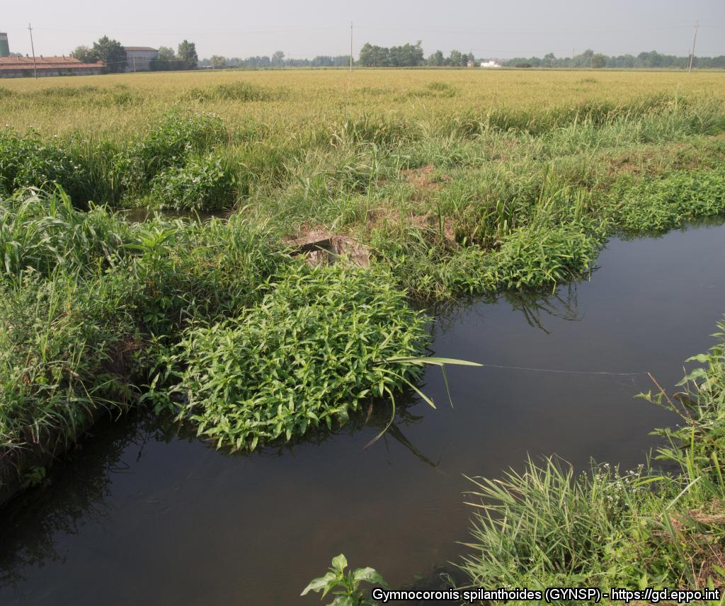
What is G. spilanthoides? What is the problem? Where is it found?
Gymnocoronis spilanthoides is an aquatic water plant, native to South America and is an EPPO A2 pest, recommended for regulation as a quarantine pest.
As Gymnocoronis spilanthoides is considered to be a serious threat to waterways, its appearance in new areas should be reported immediately to us.
Plants for planting is considered the main pathway for entry into the EPPO region. From this pathway, individual plants can be transferred to suitable habitats through either intentional introductions into the environment or unintentionally through the disposal of aquarium material. Although at an early stage of establishment in the EPPO region, G. spilanthoides, like other aquatic invasive plants can threaten biodiversity and causes other environmental damage.
In the EPPO region, G. spilanthoides is recorded from Hungary and Italy. Within its introduced range, G. spilanthoides grows in wetlands, particularly degraded waterways forming marginal clumps on the edge of slow flowing or still water bodies, also forming dense sprawling floating mats in rivers (including tidally influenced areas) and reservoirs, irrigation channels, ponds, lakes, canals and ditches. It also grows in marshes and swamps, especially where nutrient enriched. G. spilanthoides established but did not persist in a rice field in Italy.
Images: Claudio Ballerini, EPPO Global Database
Images: Claudio Ballerini, EPPO Global Database
Images: Claudio Ballerini, EPPO Global Database

