Slide 1
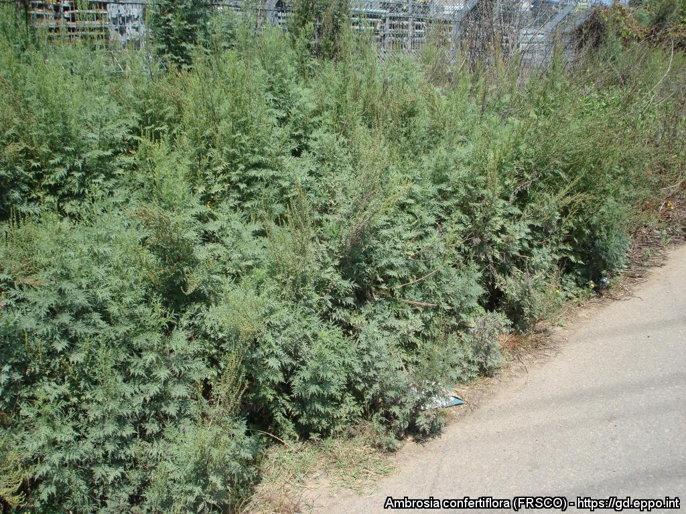
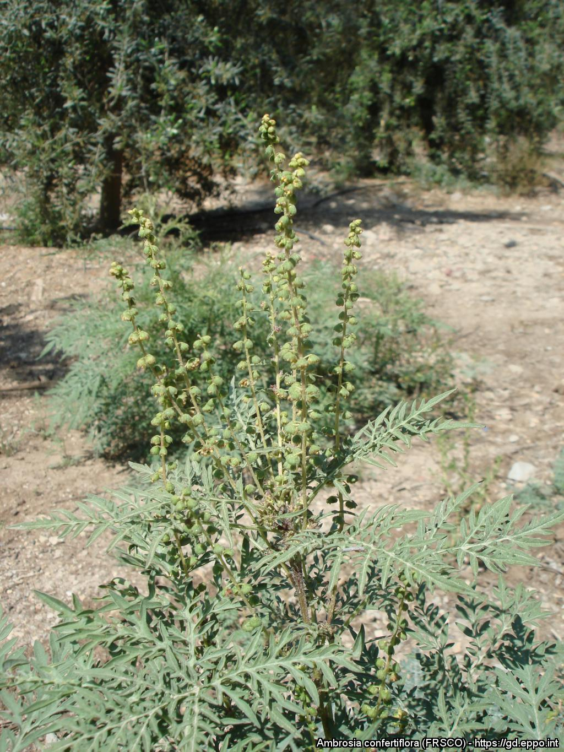
BE AWARE!
Ambrosia confertiflora
A threat to the EPPO region
How to recognize it? Can you help us?
The leaves have short petioles and are bipinnate, divided into long lobes; their margins have sparse short hairs. The leaves are opposite at the base of the stem and alternate on the upper part of the plant. The leaves release a characteristic strong smell that may help to identify the plant. Ambrosia confertiflora is monoecious and has male and female yellow or greenish flowers. The male flowers are numerous and small (diameter about 1 cm) and are borne on erect clusters. The female flowers lack petals and are concentrated in the leaf axils in a cup-shaped involucre.
Because Ambrosia confertiflora has the potential to impact the habitats it invades, including native plant species and important ecosystem services, it is important to report any sightings to plant protection authorities. Early detection will allow a rapid implementation of appropriate measures against Ambrosia confertiflora.
If you see Ambrosia confertiflora:
Check the identification of the species with other similar species.
Whenever possible, take a picture of the plant, record exact location, date and habitat where it was observed.
Contact us.
Contact us
Image: Swen Follak, EPPO Global Database
Your contact details
Your institution name
Logo
Image: Swen Follak, EPPO Global Database
This leaflet has been prepared within the LIFE funded project LIFE15 PRE FR 001 in collaboration with the NERC Centre for Ecology and Hydrology
Prepared in collaboration with EPPO – www.eppo.int

Slide 2
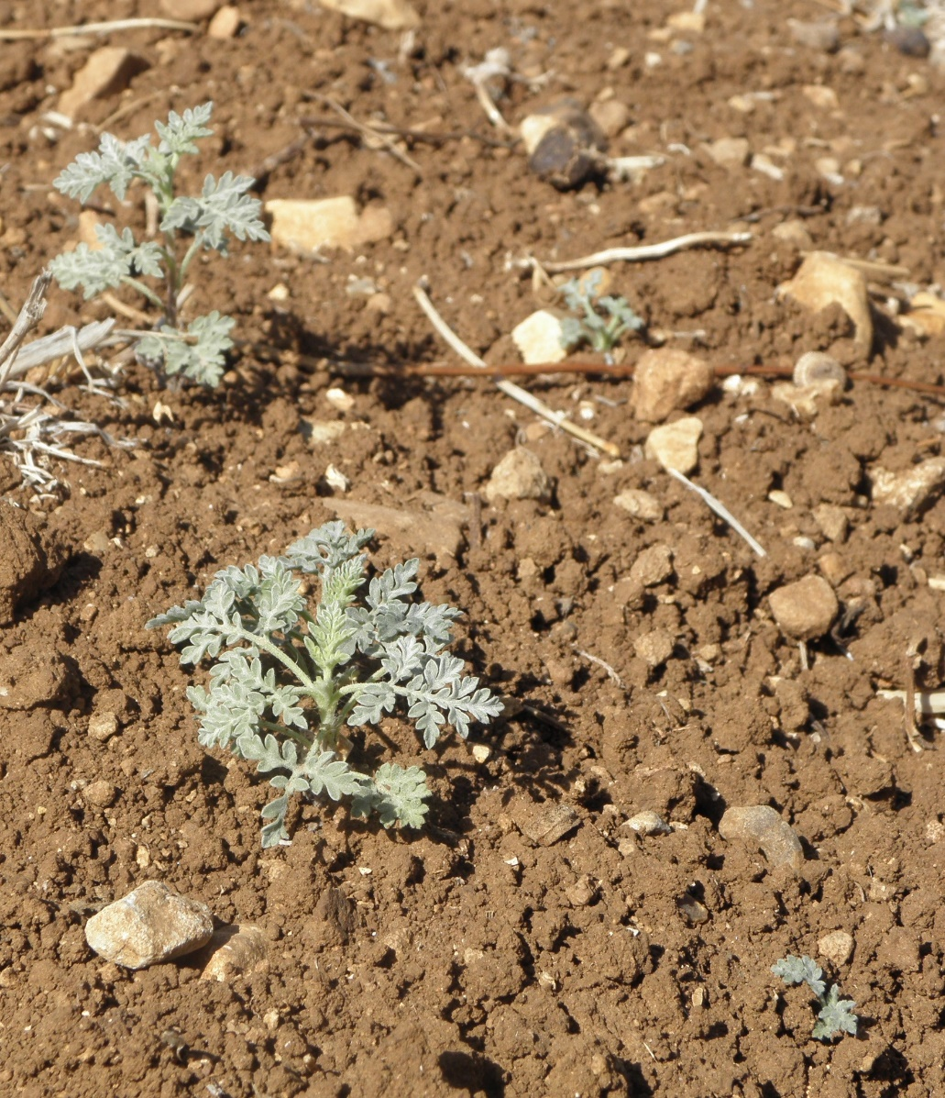
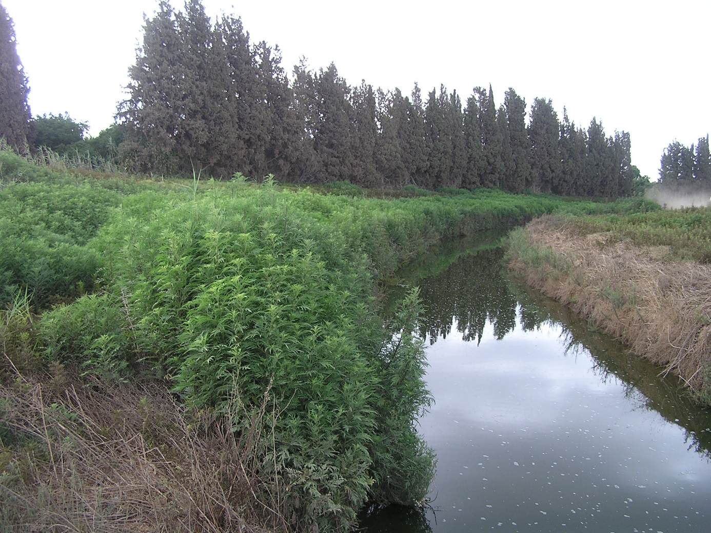
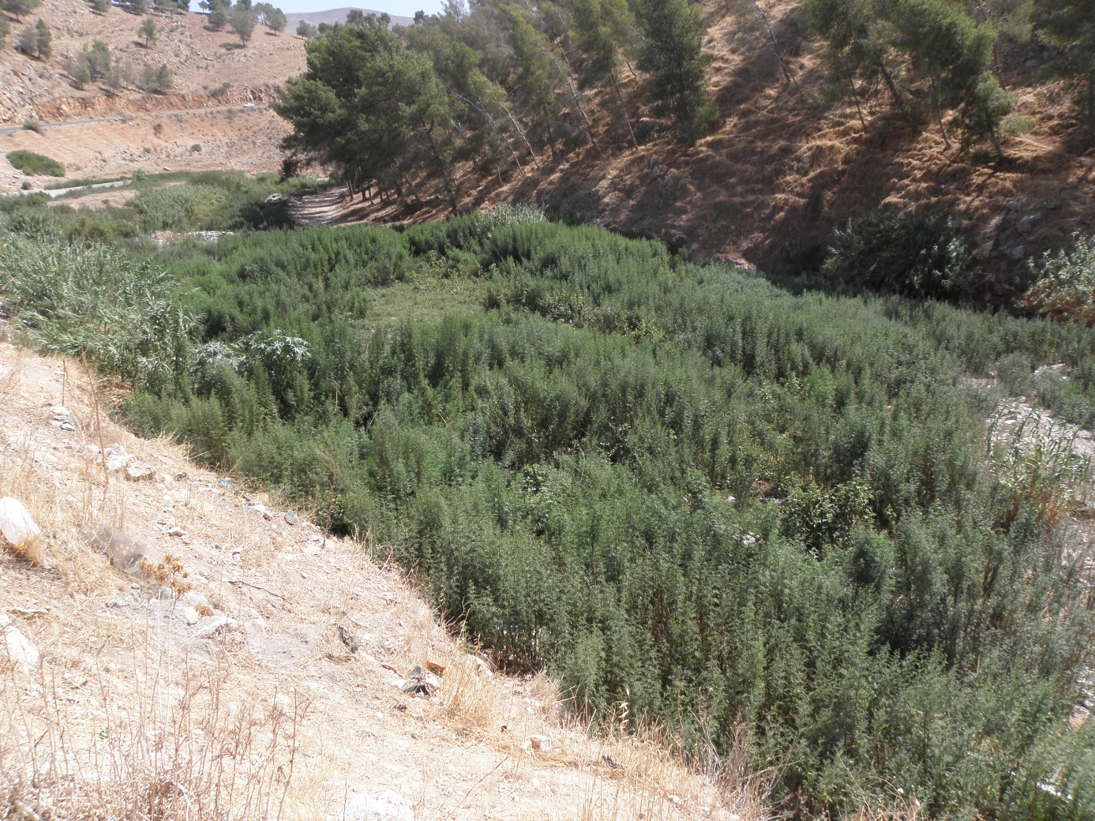
What is A. confertiflora? What is the problem? Where is it found?
Ambrosia confertiflora (EPPO List of invasive alien plants) is an erect perennial herb (Hemicryptophyte) native to North America and non-native to Australia and Israel.
As Ambrosia confertiflora is considered to be a threat to native biodiversity, its appearance in new areas should be reported immediately to us.
There is no clear information on the pathway of entry of A. confertiflora into the EPPO region (Israel). Contamination of livestock from Australia, animal seed mixture and contamination of machinery by seed are all possible pathways. A. confertiflora forms dense stands that can outcompete native plant species. A monoculture can act to suppress understory native plants which results in environmental impacts, in particular in humid habitats, in grasslands and in dry river beds. The plant competes for nutrients and can spread among cultivated fields and mixes with crops which cannot be harvested properly.
The species is absent from Europe.
In Israel, Ambrosia confertiflora occurs in various natural and disturbed habitats, including dry plains and semi-arid valleys, degraded pastures, cultivated orchards, summer field crops (cotton and water melon) avocado and date groves, along roadsides, river-banks, and wadi beds (dry river beds), in wastelands and other disturbed areas.
Image: Swen Follak, EPPO Global Database
Image: Jean-Marc Dufour-Dror, EPPO Global Database
Image: Jean-Marc Dufour-Dror, EPPO Global Database

