Slide 1
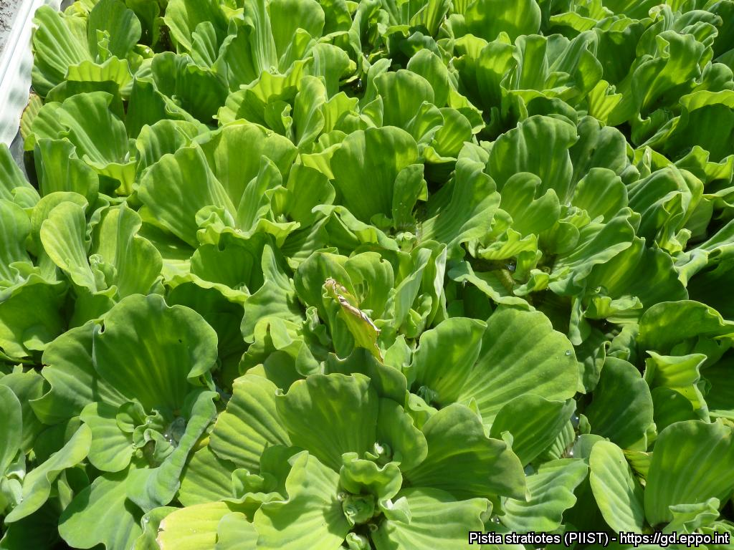
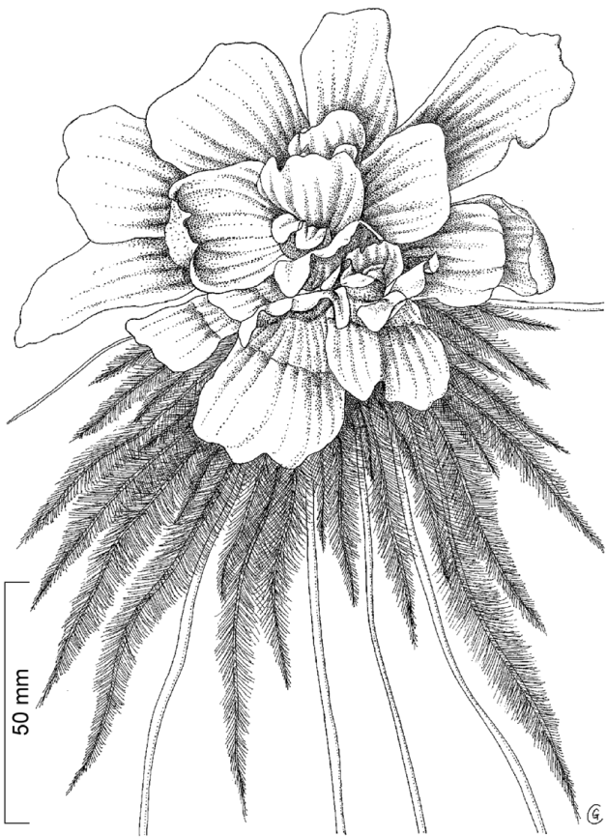
BE AWARE!
Pistia stratiotes
A threat to waterways in the EPPO region
How to recognize it? Can you help us?
Pistia stratiotes is a free floating plant with a rosette of obovate to spatulate, short haired leaves (up to 35 cm in European forms). The upper sides of the leaves are light-green, while the undersides are almost white. The floating plants have a large feathery root systems which hangs freely in the water. The solitary inflorescence is axillary and inconspicuous, with short peduncles in the center of the rosette. The spadix, with a single pistillate flower and several staminate flowers enclosed in a whitish spathe, is pale green, hairy outside and glabrous inside.
Because Pistia stratiotes can seriously impact the habitats it invades, including native plant species, associated insects and important ecosystem services, it is important to report any sightings to plant protection authorities. Early detection will allow a rapid implementation of appropriate measures against Pistia stratiotes.
If you see Pistia stratiotes:
Check the identification of the species with other aquatic native plants.
Whenever possible, take a picture of the plant, record exact location, date and habitat where it was observed.
Contact us.
Contact us
Image: Anne-Sophie Roy, EPPO Global Database
Your contact details
Your institution name
Logo
This leaflet has been prepared within the LIFE funded project LIFE15 PRE FR 001 in collaboration with the NERC Centre for Ecology and Hydrology
Prepared in collaboration with EPPO – www.eppo.int

Slide 2
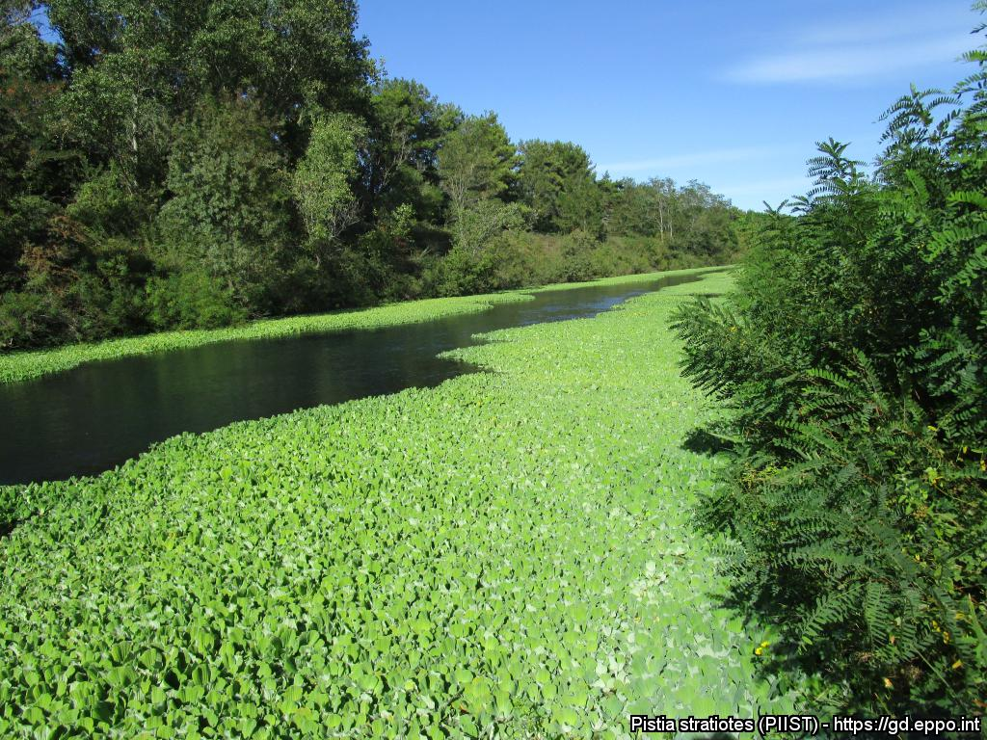
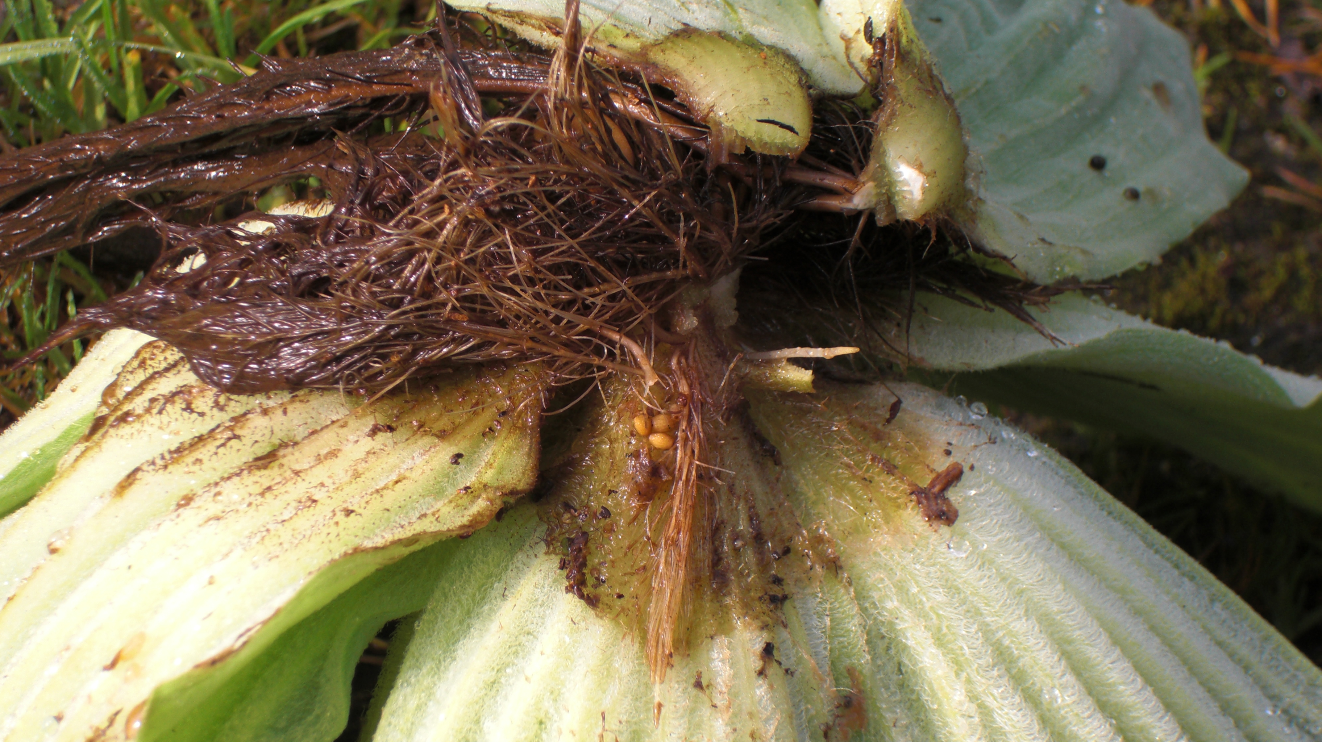
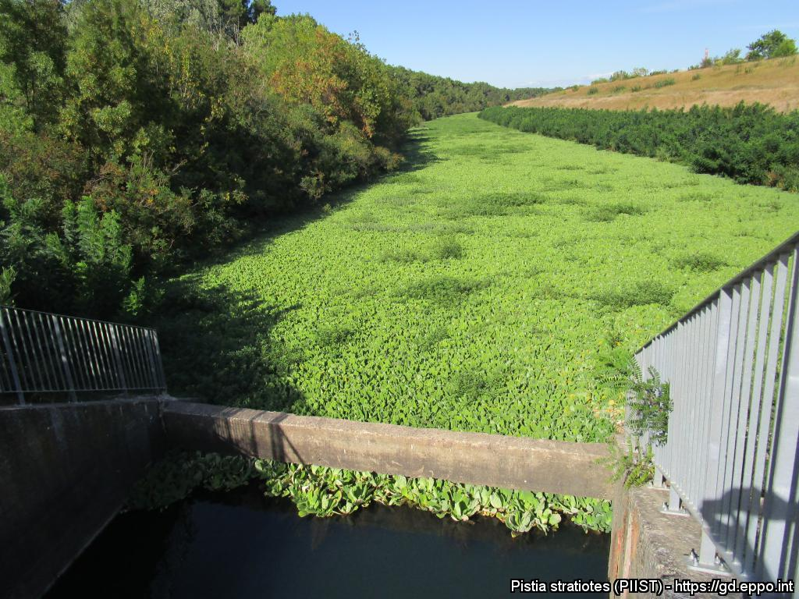
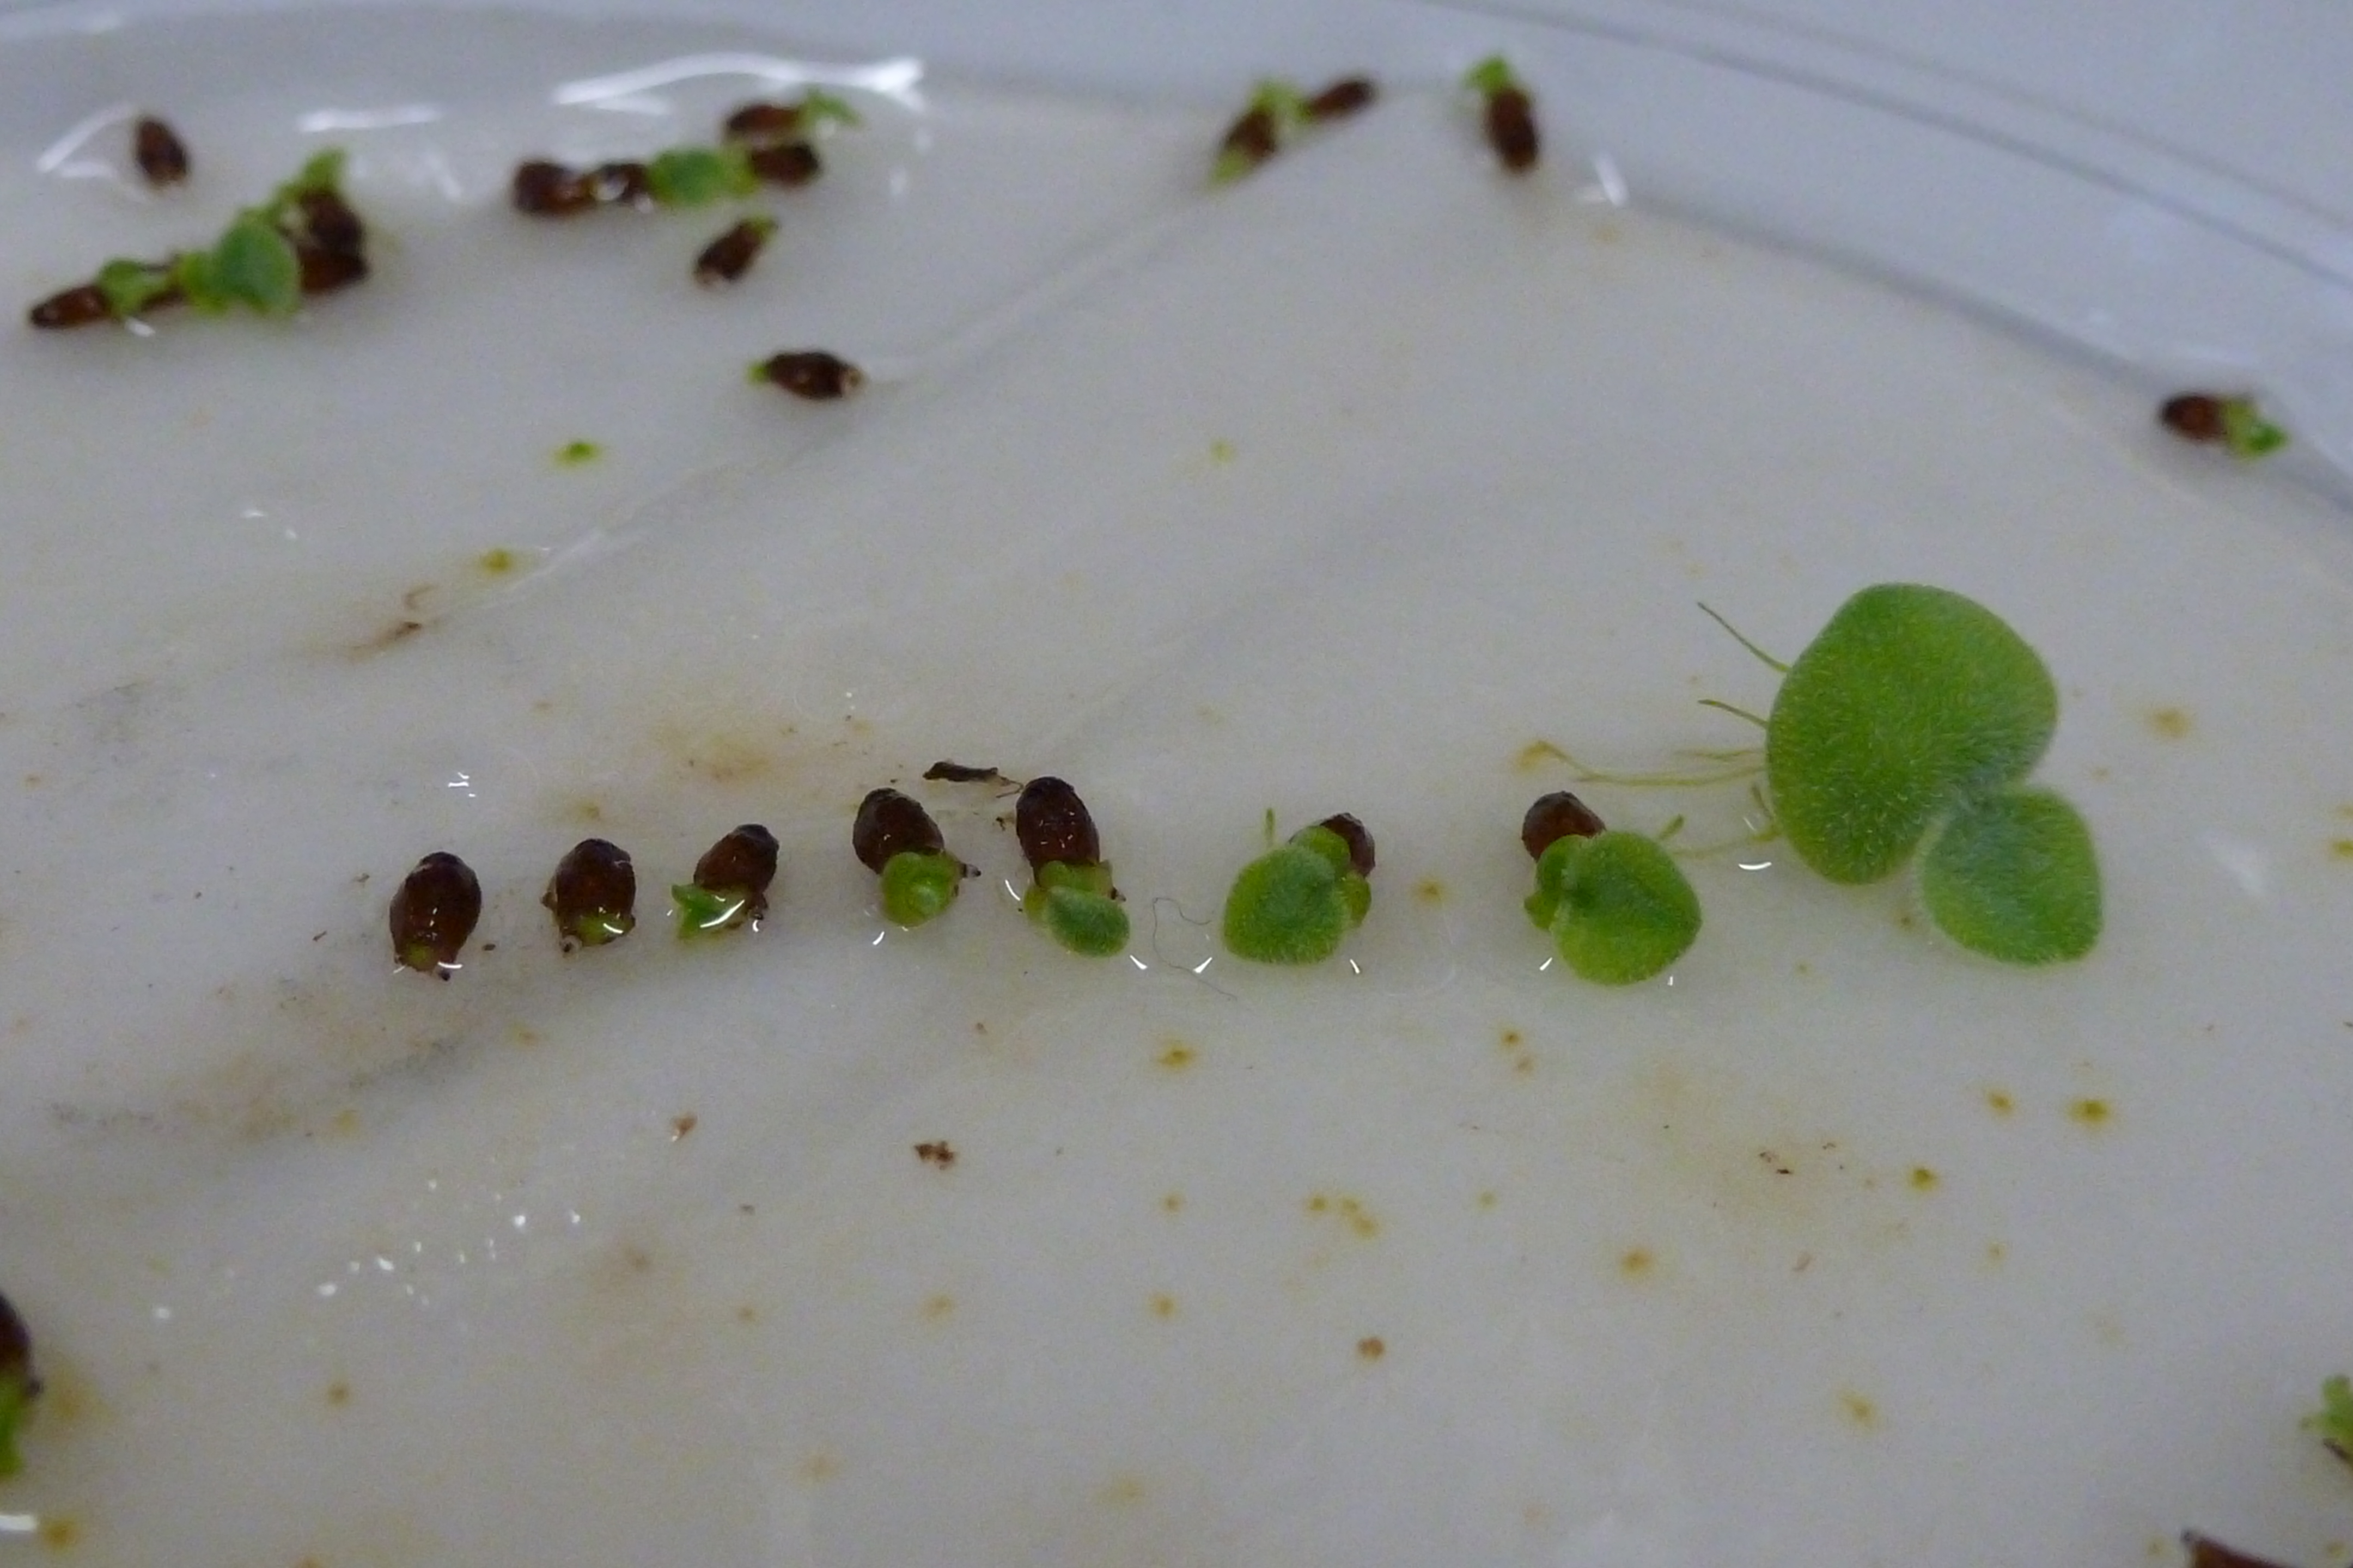
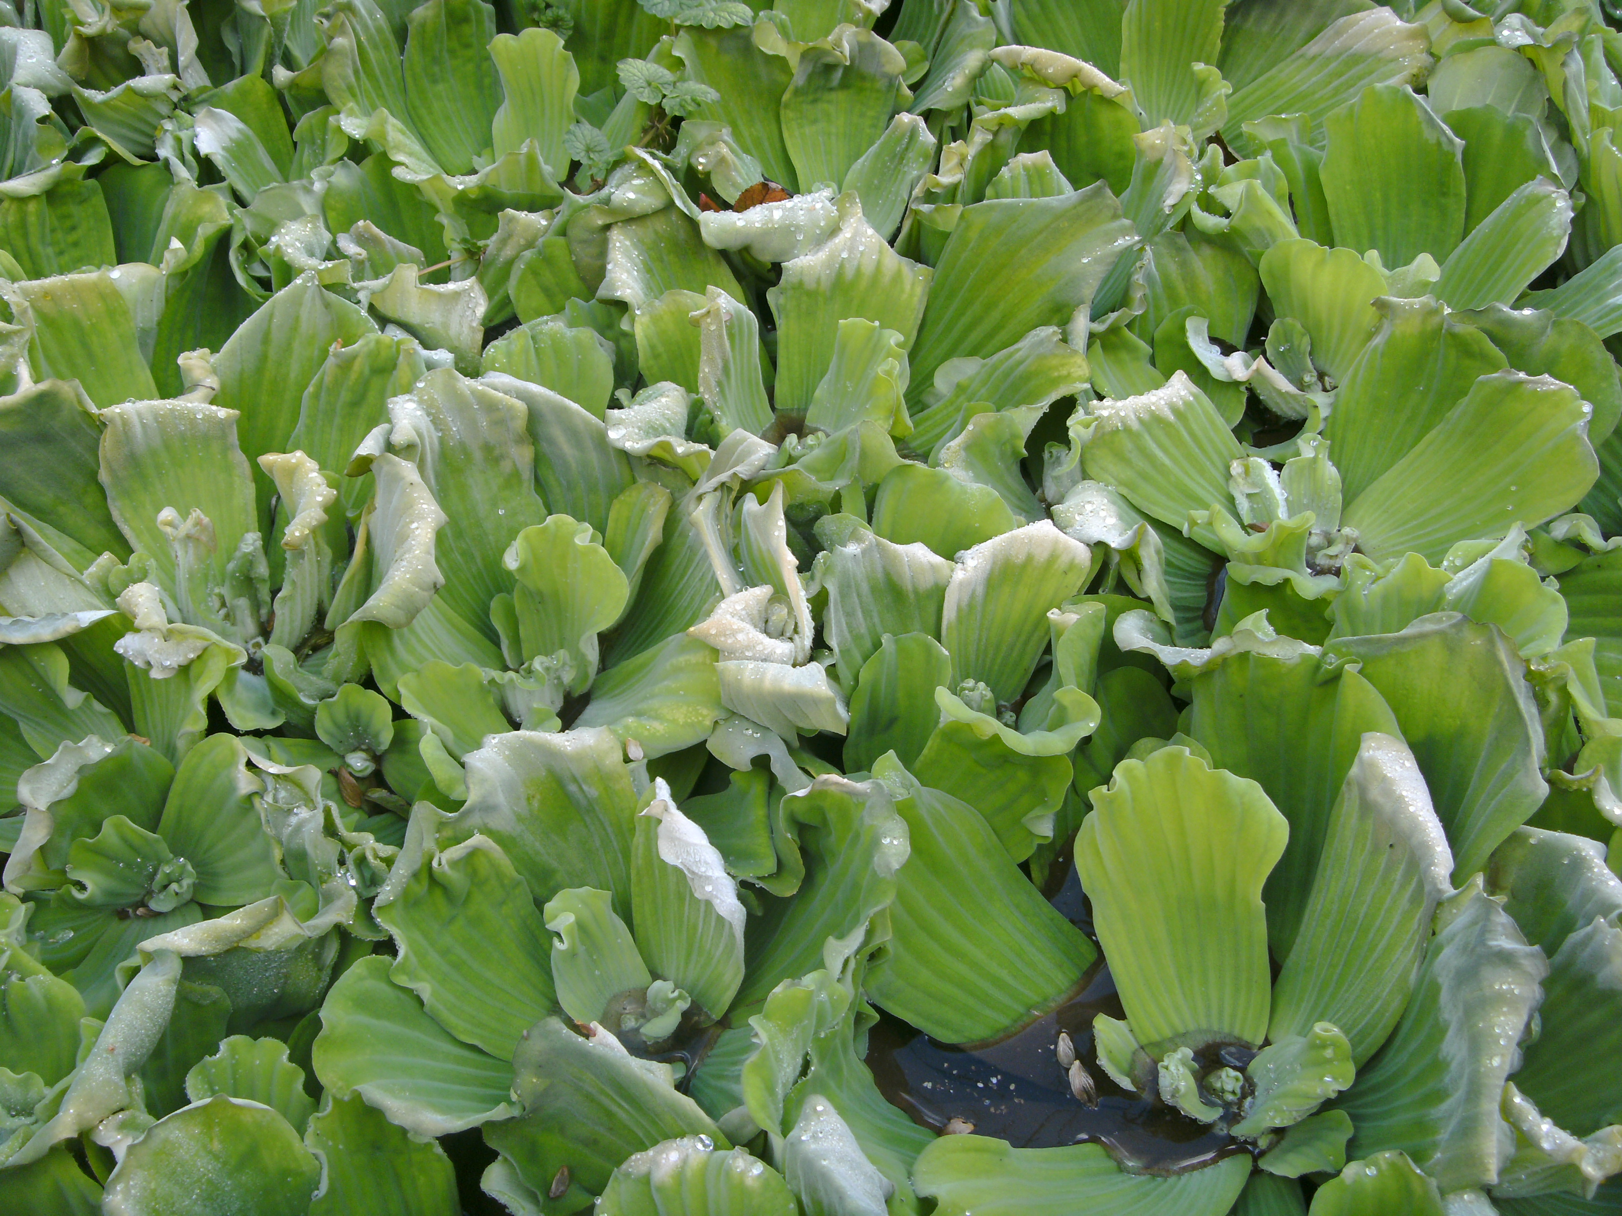
What is Pistia stratiotes? What is the problem? Where is it found?
Dense mats of P. stratiotes can block sunlight, reducing primary production, decreasing water turbidity and outcompete native plant species. Furthermore, the water shaded by P. stratiotes shows decreased levels of oxygen and increased levels of nitrate, ammonium and phosphorus. As a result of the altered habitat, submerged vegetation has been shown to decrease under dense mats along the river Erft in western Germany. Pistia stratiotes mats clog waterways and limit the recreational use of water bodies, reduce the efficiency of irrigation and drainage systems and increase water loss due to evapotranspiration.
Pistia stratiotes forms dense mats at the surface of the water. Pistia stratiotes grows in aquatic habitats such as lakes, canals, reservoirs and slow moving rivers. The species can survive drying, and can reinfest ephemeral waters which are subject to seasonal drying, because of seed survival and germination.
Image: Jean-Philippe Reygrobellet, EPPO Global Database
Pistia stratiotes is an aquatic water plant, native to South America and is an EPPO A2 pest, recommended for regulation as a quarantine pest. In the EPPO region, Pistia stratiotes is recorded from Austria, Belgium, Czech Republic, France, Germany, Hungary, Israel, Italy, Morocco, Netherlands, Norway, Portugal, Romania, Russia, Slovenia, Spain, United Kingdom.
As Pistia stratiotes is considered to be a serious threat to waterways, its appearance in new areas should be reported immediately to us.
Image: Jean-Philippe Reygrobellet, EPPO Global Database
Images: Andreas Hussner, EPPO Global Database
Image: Andreas Hussner, EPPO Global Database

