Slide 1
IMPLANT Denmark
Activities 2017

Slide 2
Bugs in your luggage?

Slide 3
Purpose
To draw attention to the Agency's work on plant health
To get public to help us keep quarantine pests out of Denmark by raising awareness of the plant health risk by mowing plants among countries

Slide 4
Activities and results
Information about the risk by taking plants with you at home when you are travelling and information about luggage rules for importing plants and plant products
Event: Dialogue with public at Copenhagen Airport and the metro, and distribution of postcards and luggage tags (about 1000 people reached / 3000 postcards distributed)
Media efforts: Coverage of the message on TV (TV2 Lorry) and many of the major nationwide media online channels: DR.dk, TV2.dk, JP.dk, EB.dk, BT.dk, etc.
Social Media: Spread the message through Facebook, YouTube, Twitter and Linkedin (total 35,000 views)

Slide 5
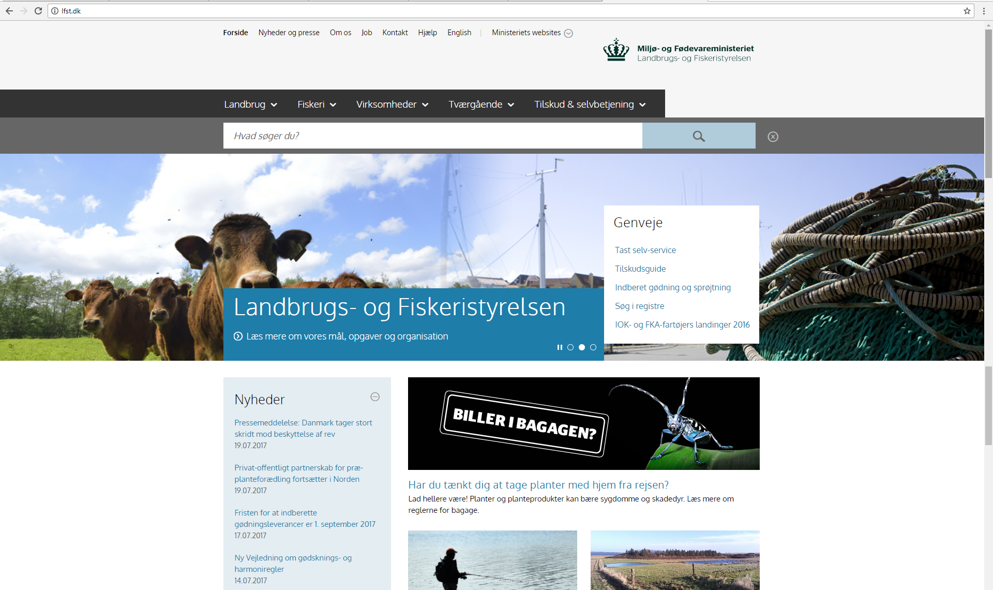
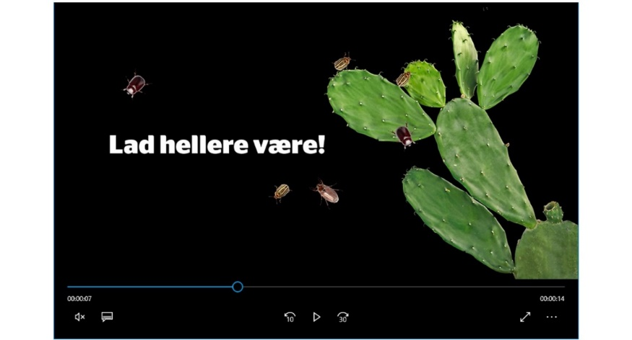
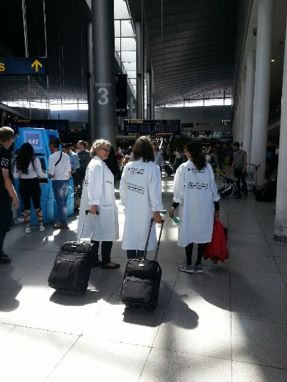
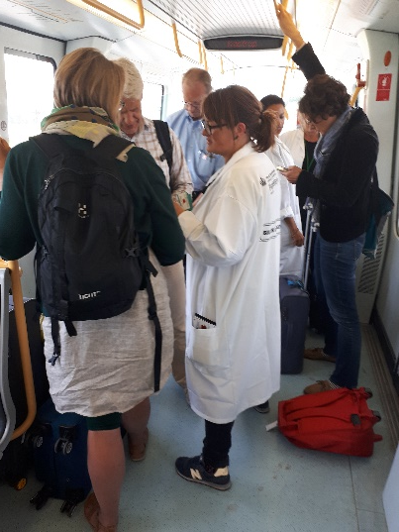
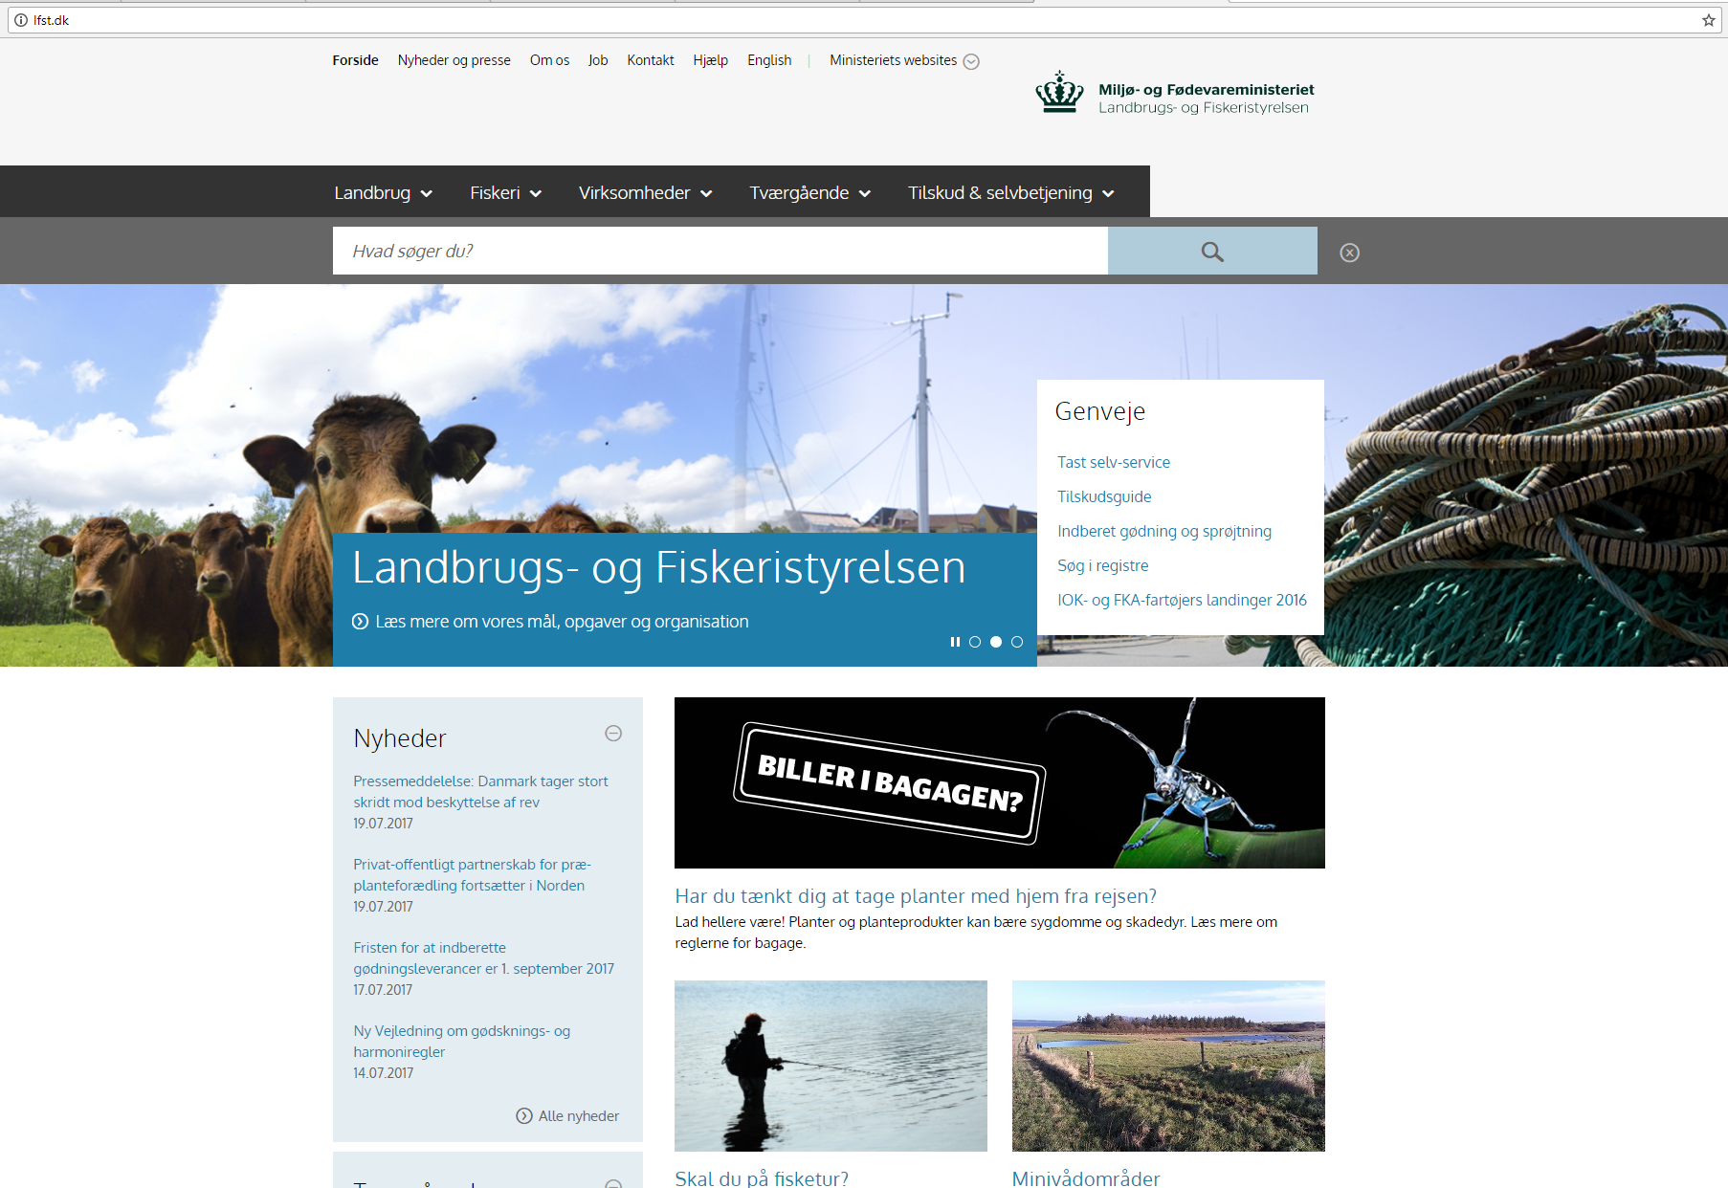
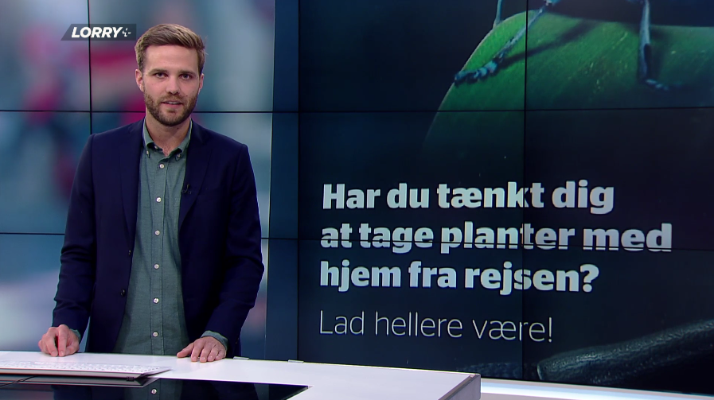
CAMPAIGN BUGS IN YOUR LUGGAGE? Are you thinking about taking plants with you at home? You better dont!

Slide 6
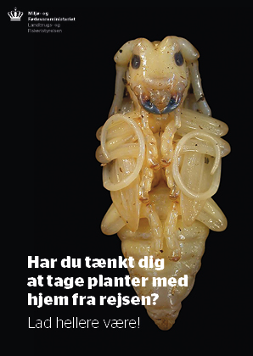
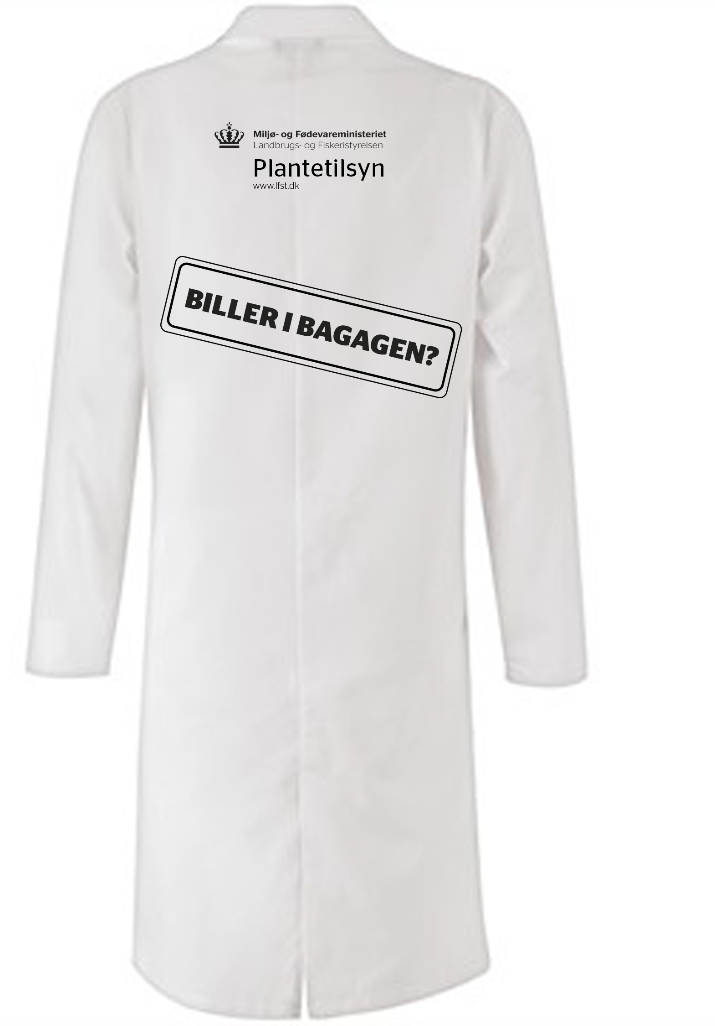
CAMPAIGN BUGS IN YOUR LUGGAGE? GRAPHIC MATERIALS
Postcard
Video
Coat
Kuffertmærkat
Materiale til sociale medier

Slide 7
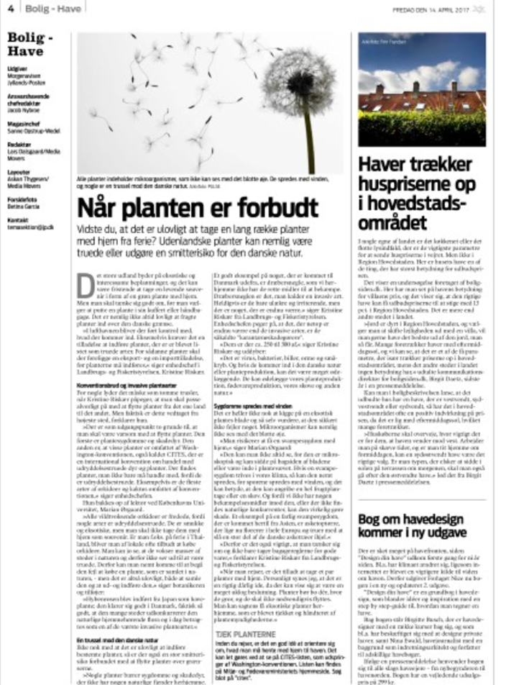
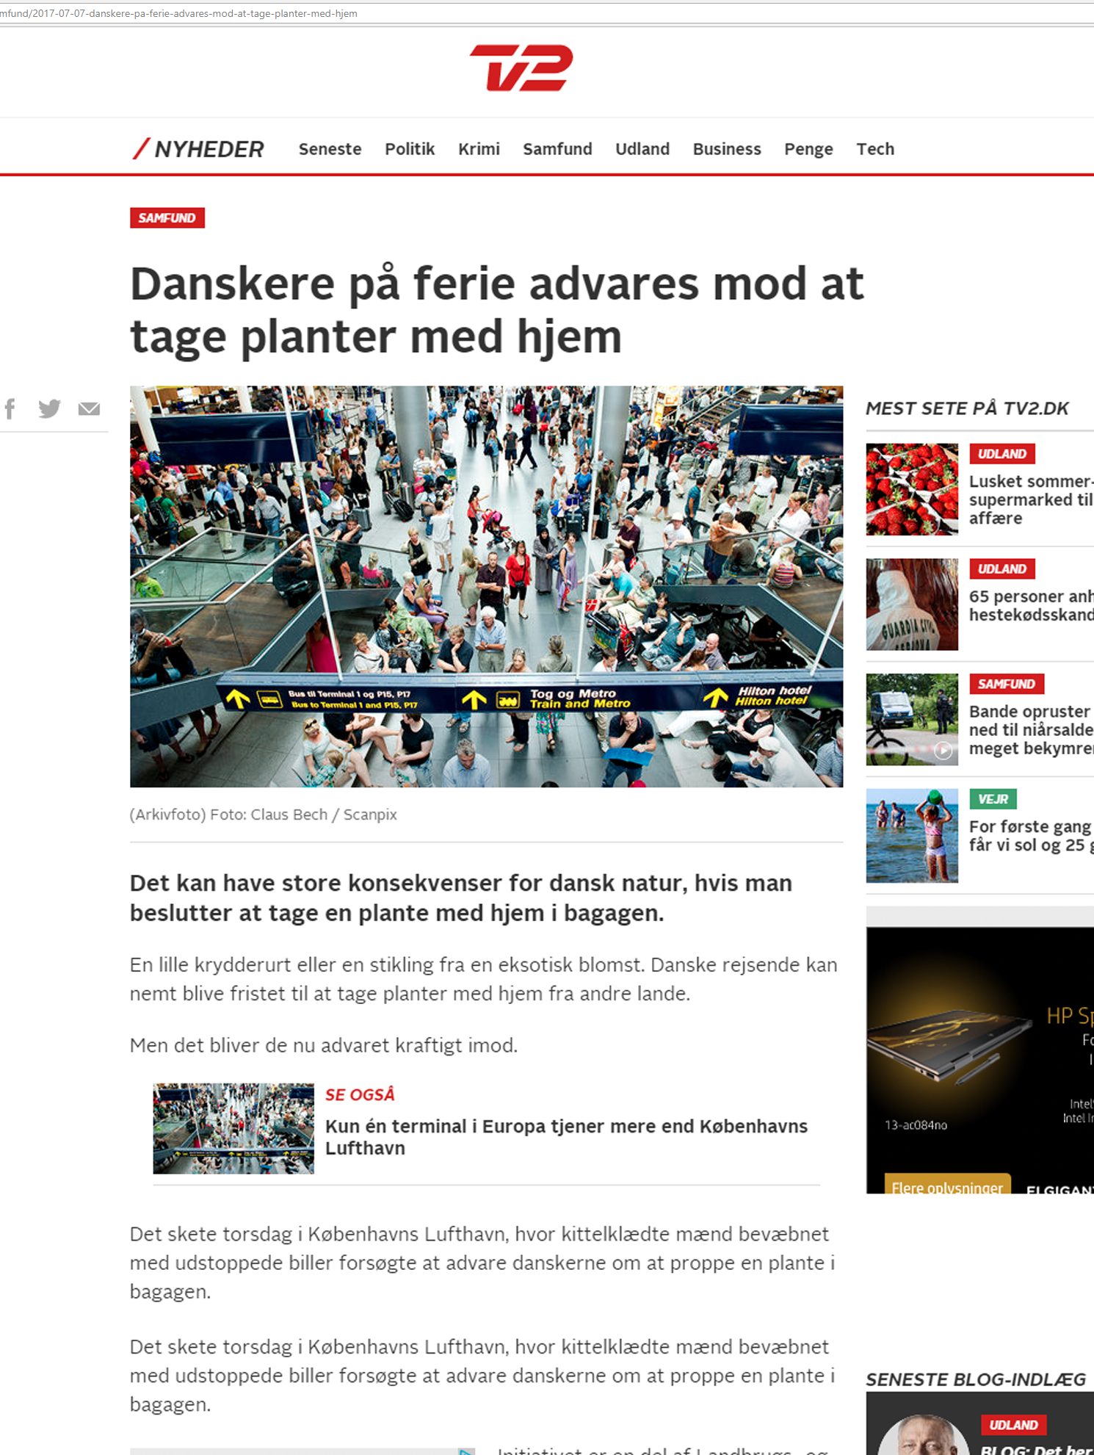
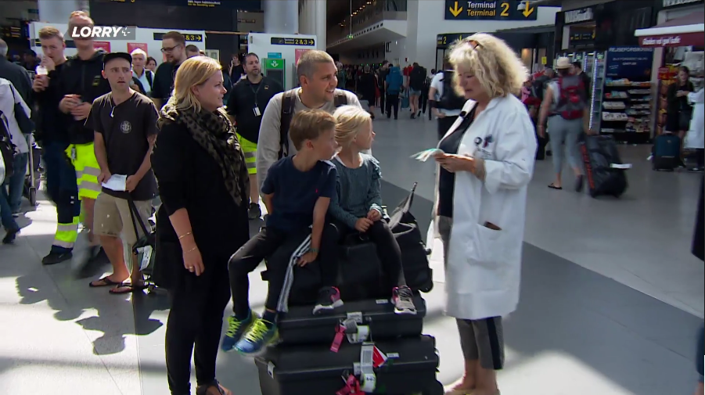
CAMPAIGN BUGS IN YOUR LUGGAGE? MEDIA COVERAGE
Indslag om kampagnen i TV2 Lorry
Artikel om kampagnen i Morgenavisen Jyllands-Posten
Artikel om kampagnen på nyhederne.tv2.dk
Der blev bragt artikler og indslag om kampagnen online i følgende medier:

Slide 8
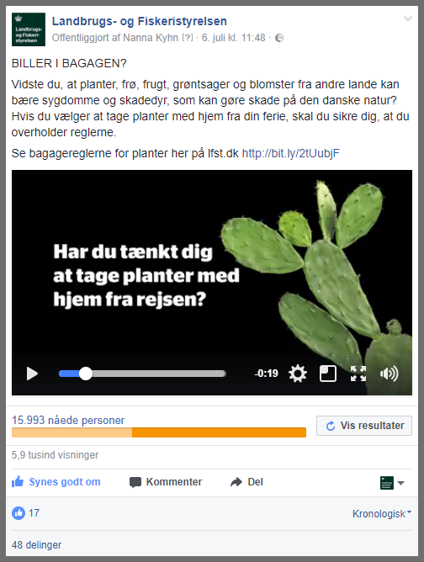
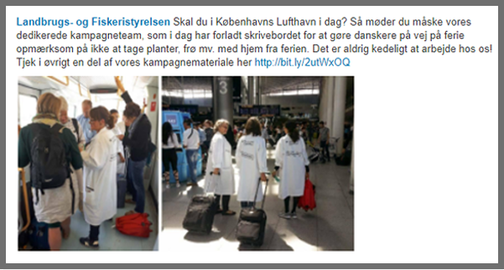
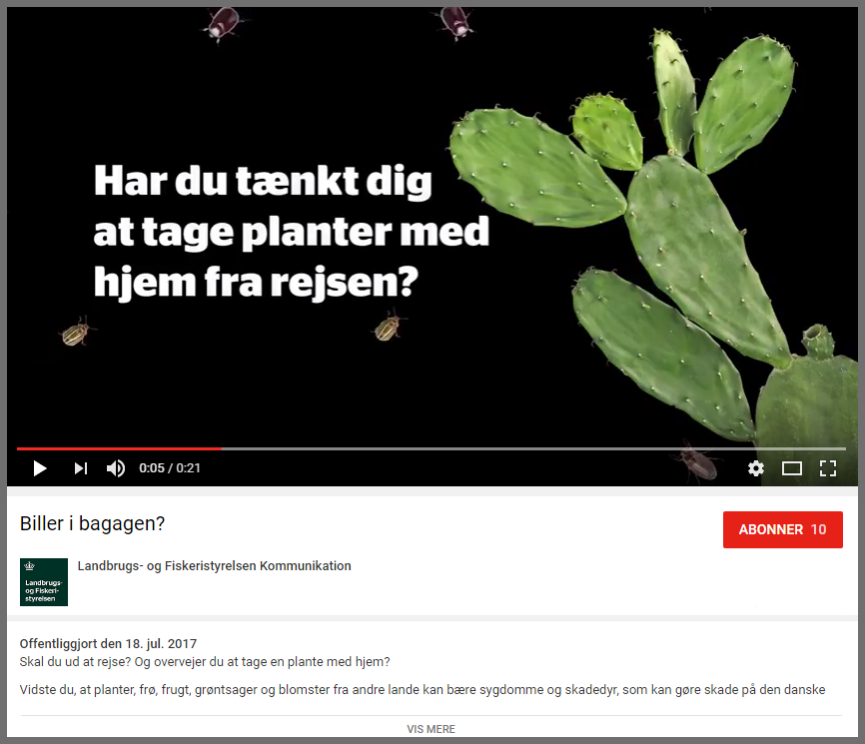
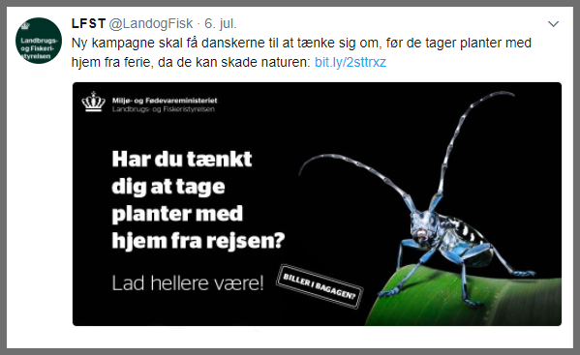
CAMPAIGN BUGS IN YOUR LUGGAGE? SOCIAL MEDIA
Facebook
Linkedin
Youtube
Twitter

Slide 9
COPENHAGEN CULTURAL NIGHT 2017
Together we ensure healthy plants

Slide 10
Purpose
To draw attention to the work of The Danish Agricultural Agency
To get the public to help us keep an eye on particularly serious diseases and harmful organisms
To provide public with tools to recognize particularly serious diseases and harmful organisms listed on the EU Quarantine List

Slide 11
Activities
Find Symptoms of the citrus long-horned beetle - Learn to Spot Symptoms of Pests
Learn about potatoes - which ones are healthy and what should you report?
Bugs in your luggage? Information about the risk by mowing plants
Children's corner with dart activity “Knock down a Quarantine Pest“ and materials for the autumn holiday: Activity booklet, memory cards and flip flap game

Slide 12
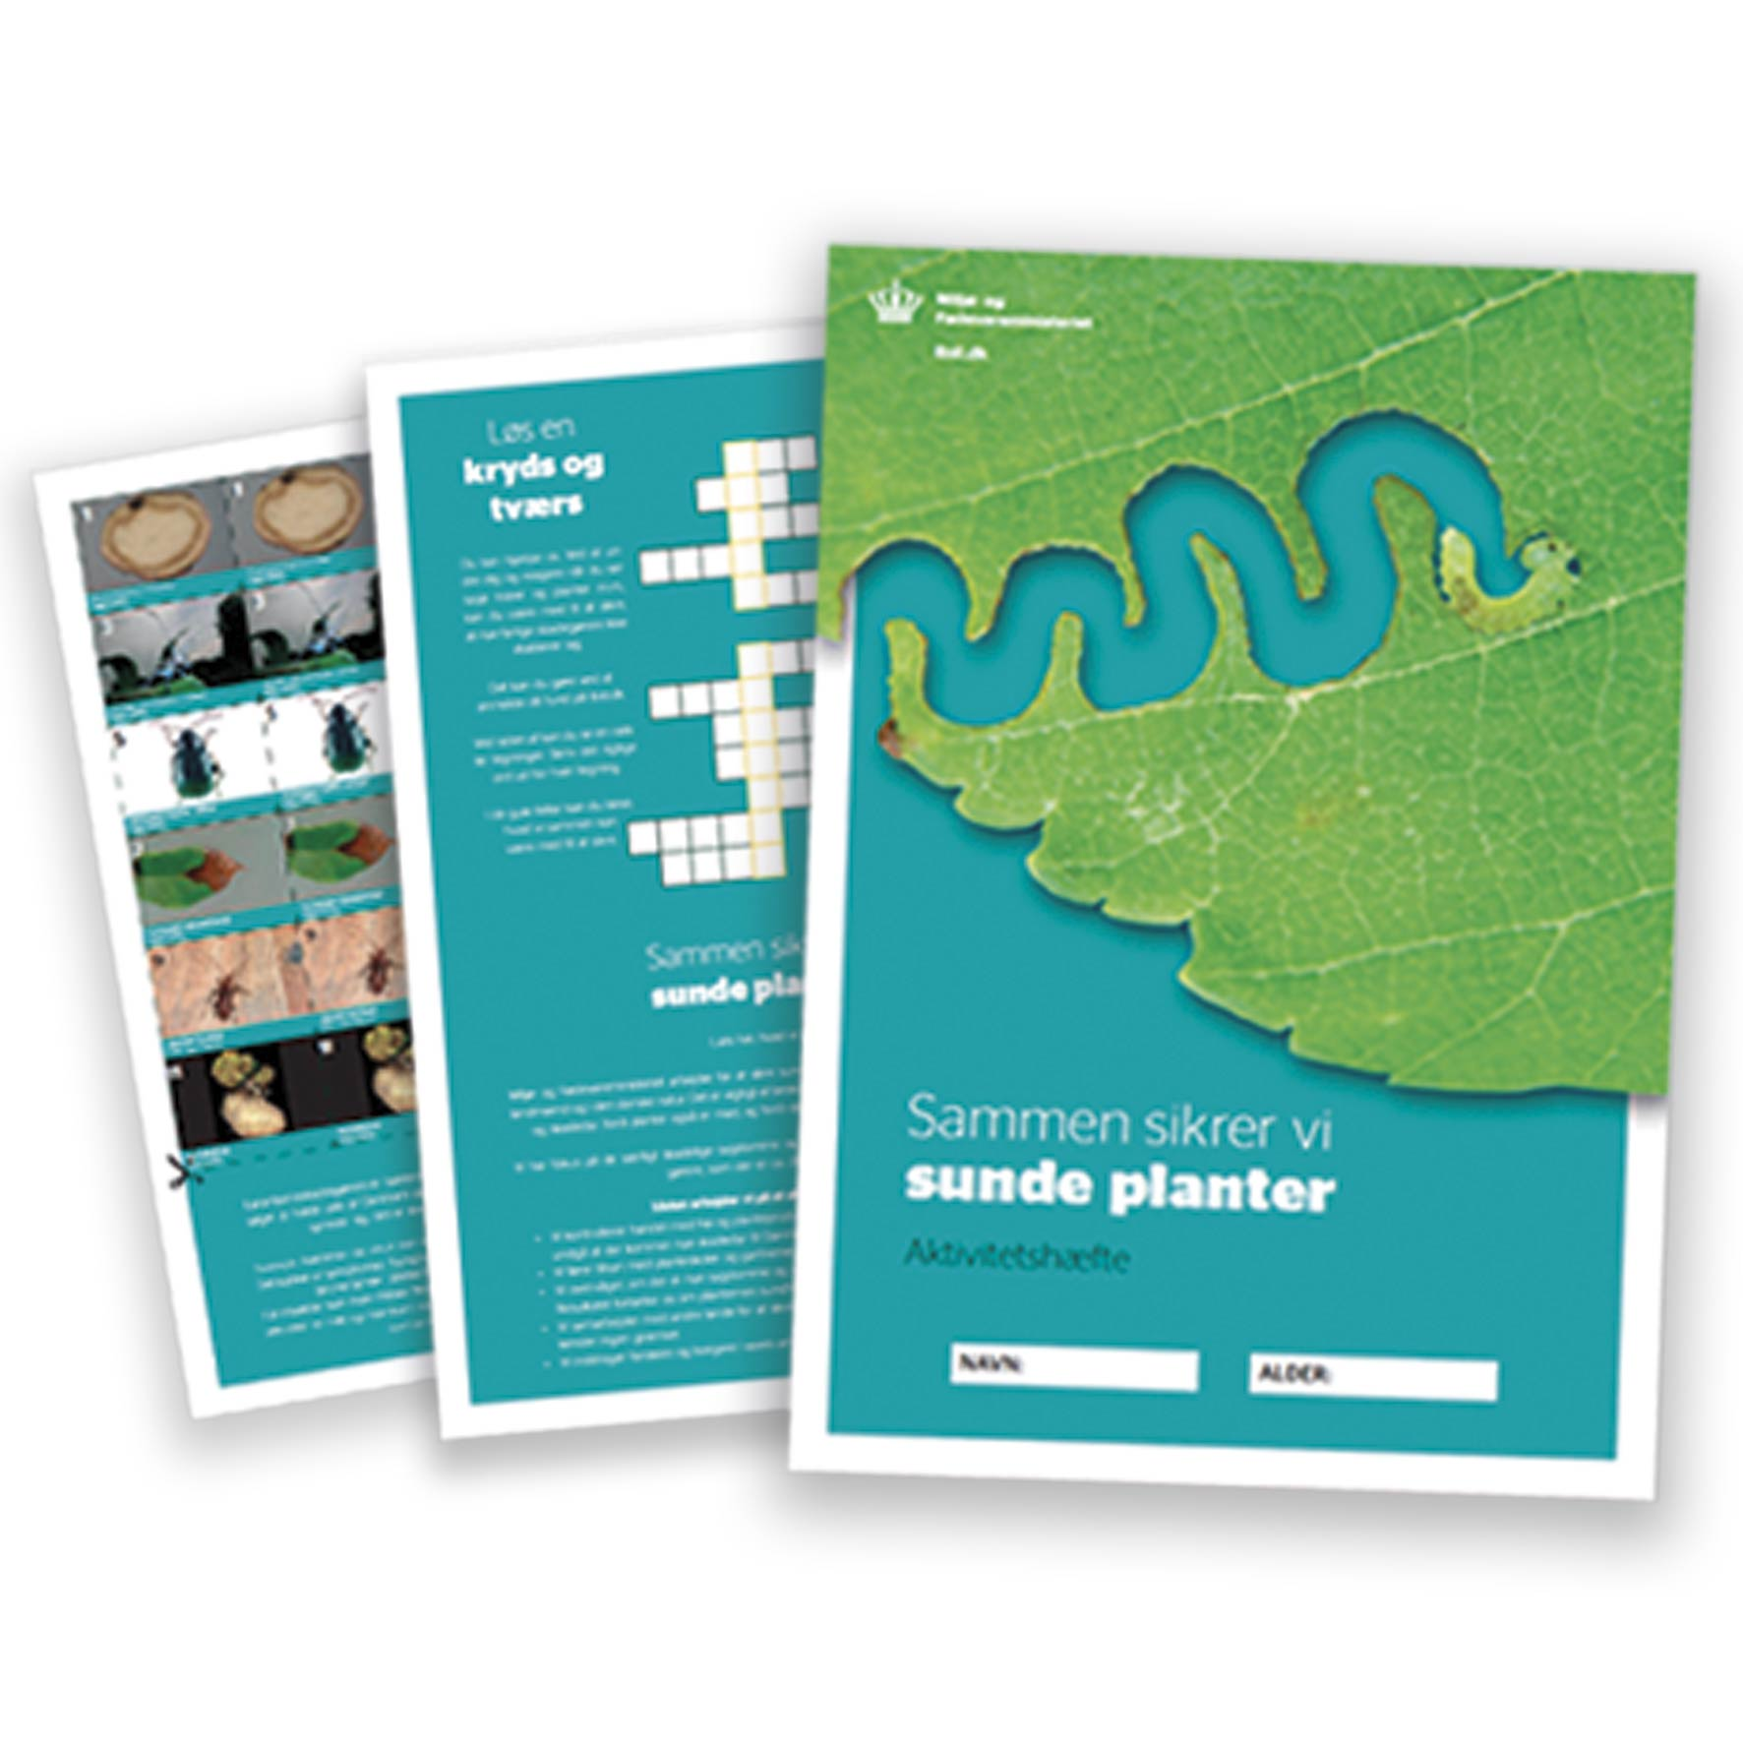
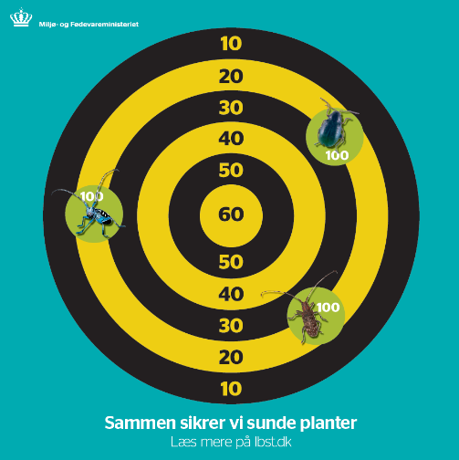
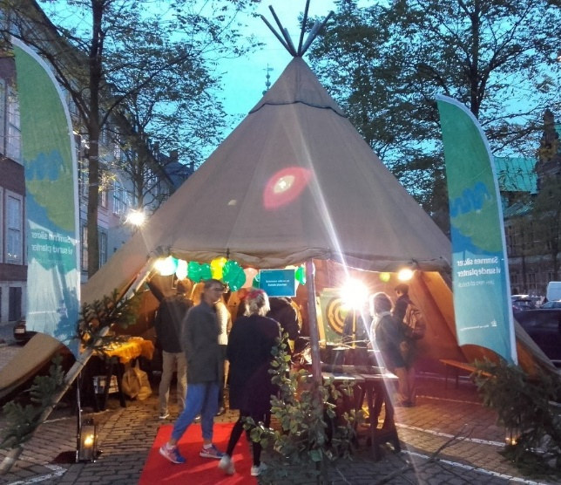
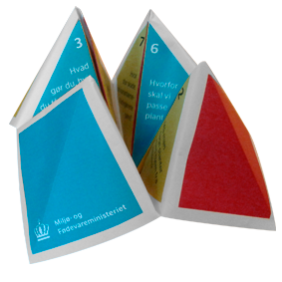
CULTURAL NIGHT 2017 TOGETHER WE ENSURE HEALTHY PLANTS

Slide 13
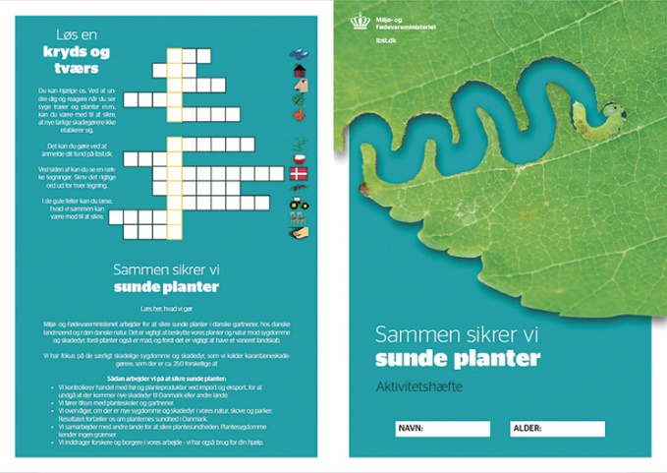
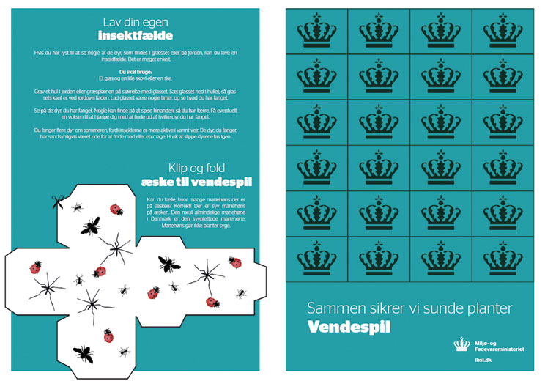
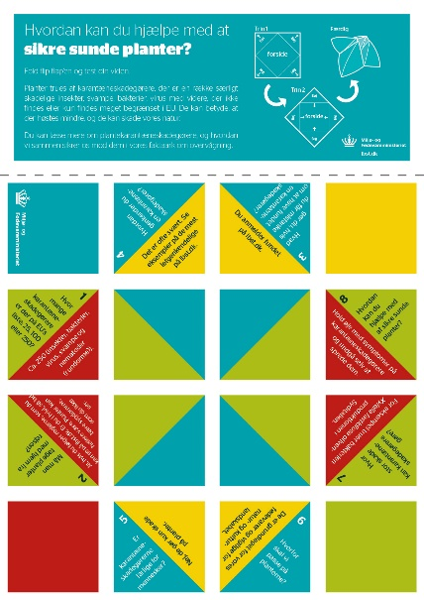
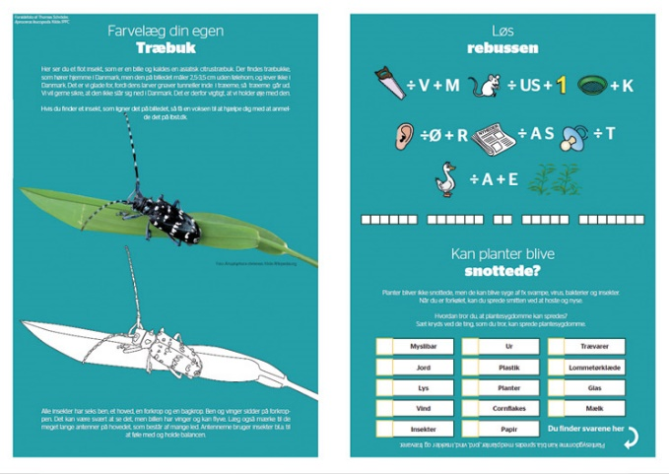
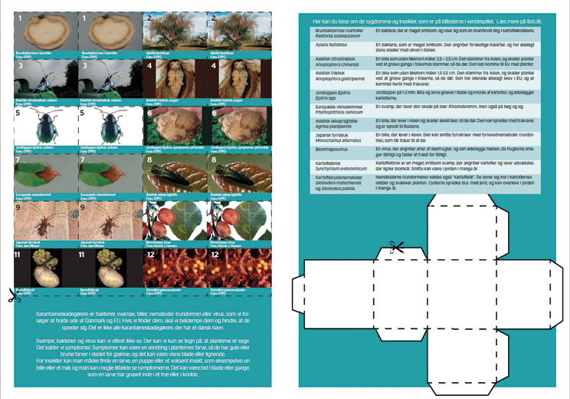
CULTURAL NIGHT 2017 TOGETHER WE ENSURE HEALTHY PLANTS MATERIALS
Activity booklet
Memory cards
Flip flap
Magneter

Slide 14
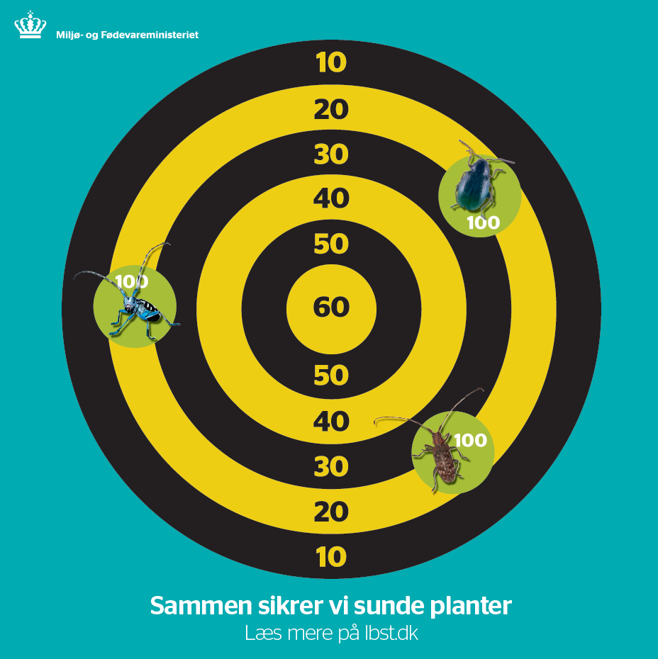
CULTURAL NIGHT 2017 TOGETHER WE ENSURE HEALTHY PLANTS MATERIALS
Bug-dart
Signs
Beach flag
Faktaark

Slide 15
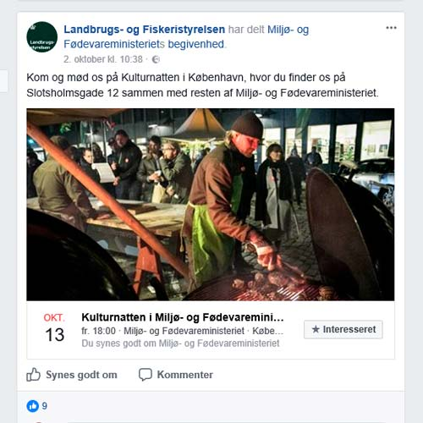
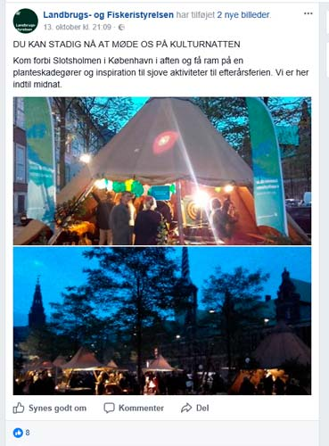
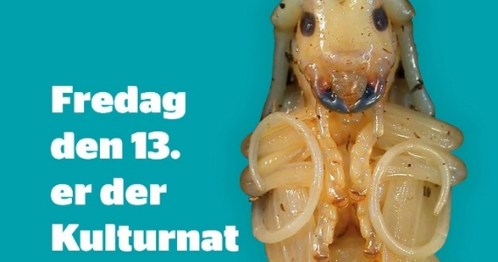
CULTURAL NIGHT 2017 TOGETHER WE ENSURE HEALTHY PLANTS SOCIAL MEDIA
Facebook og Twitter
Facebook
Youtube
Linkedin

Slide 16
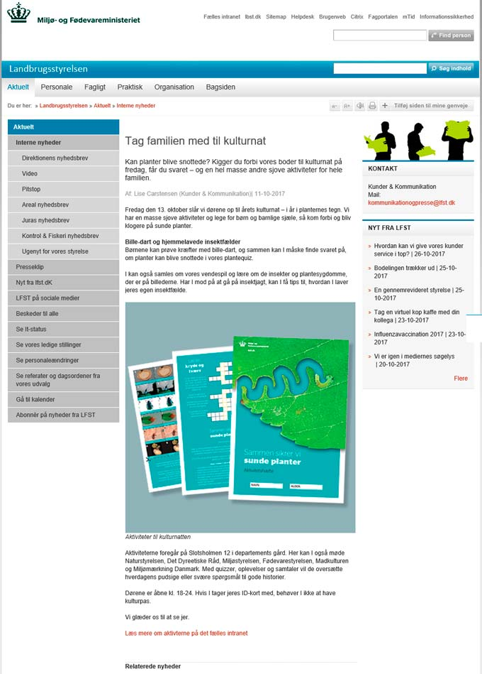
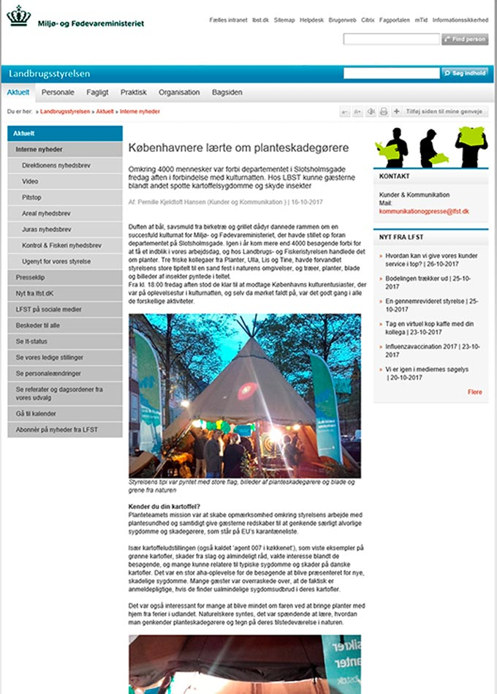
CULTURAL NIGHT 2017 TOGETHER WE ENSURE HEALTHY PLANTS INTERNAL COMMUNICATION
Intranet news
Posters for use in house

Slide 17
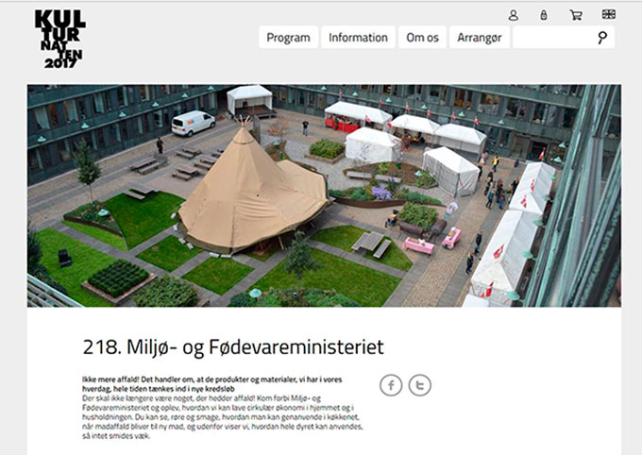
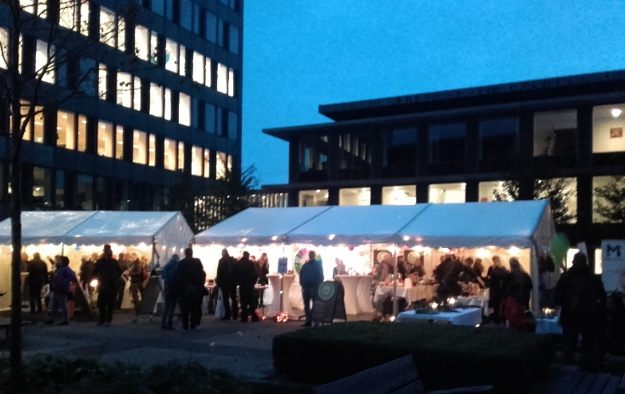
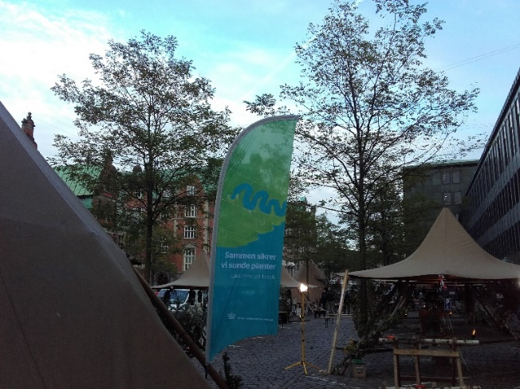
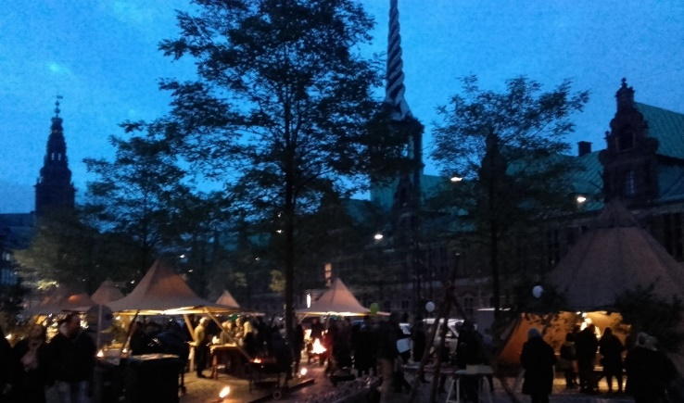
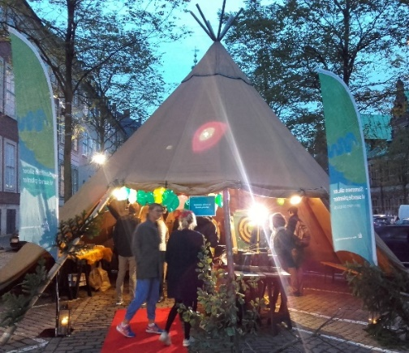
CULTURAL NIGHT 2017 TOGETHER WE ENSURE HEALTHY PLANTS COPENHAGEN
Kulturnatten.dk

Slide 18
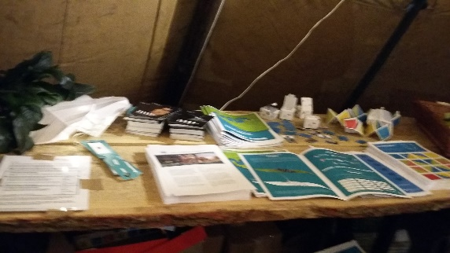
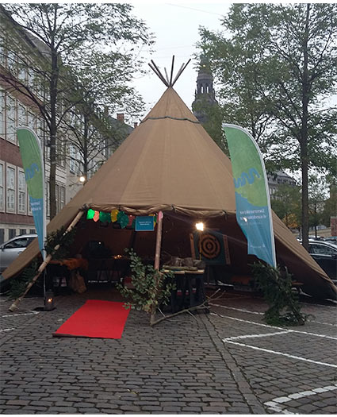
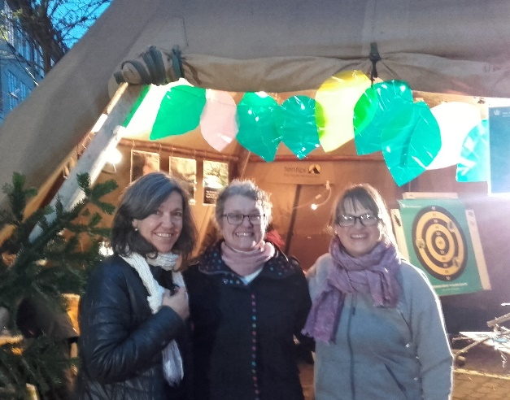
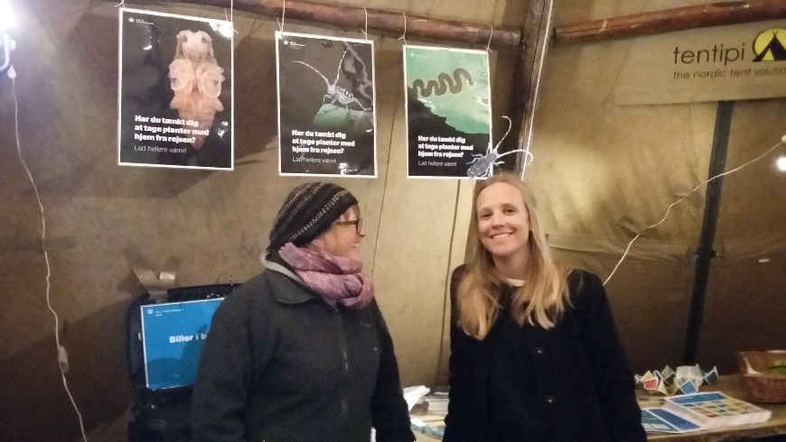
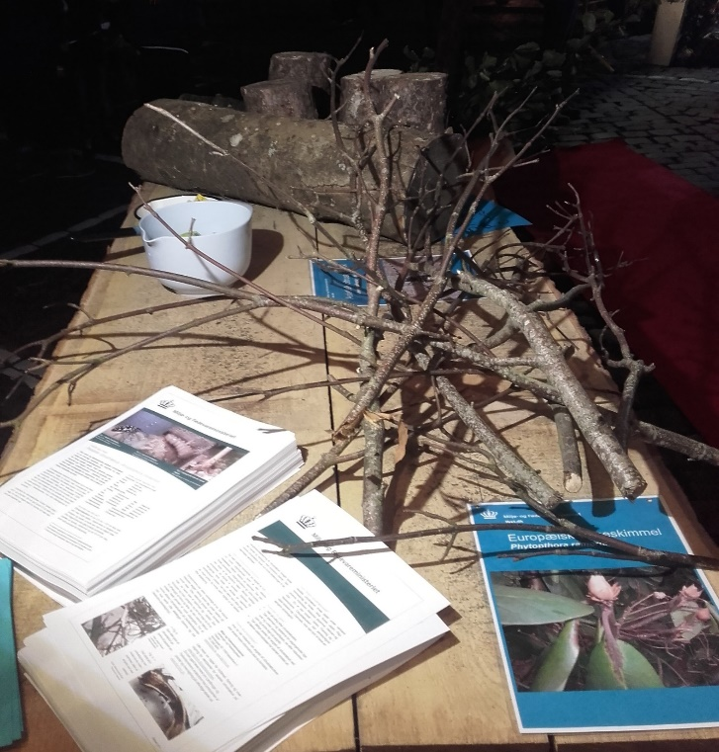
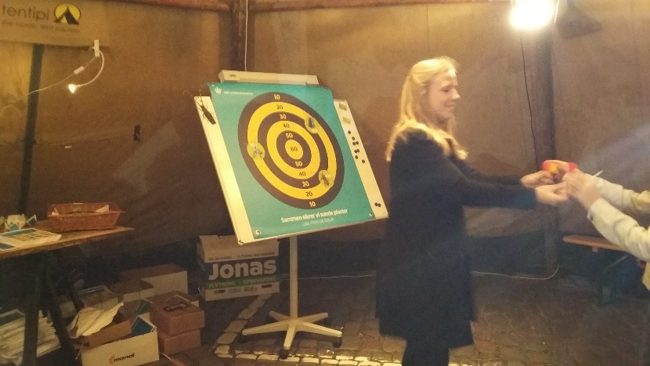
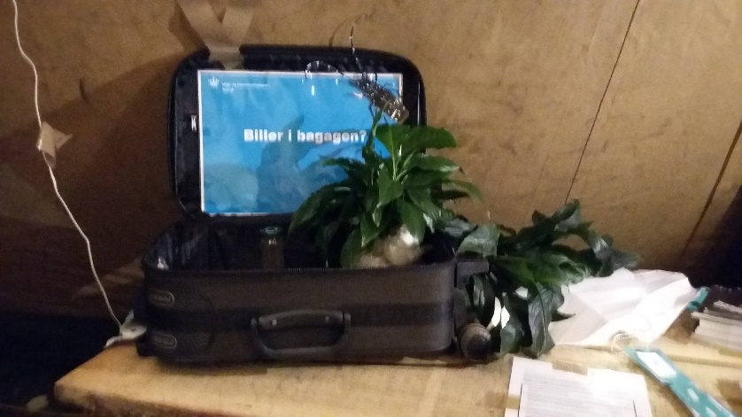
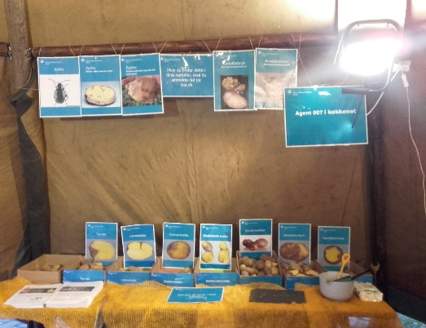
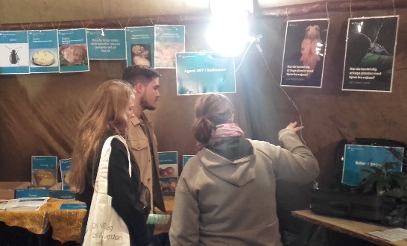
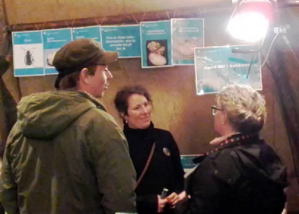
CULTURAL NIGHT 2017 TOGETHER WE ENSURE HEALTHY PLANTS COPENHAGEN 2017

Slide 19
Results
4000 visitors in Copenhagen Culture Night, October 13, 2017
Good dialogue with the public who showed great interest in our materials and activities: Activity books for children, magnets, postcards, luggage tags and fact sheets
The messages are spread through social such as Facebook, Twitter, Linkedin and YouTube

